Slide 1
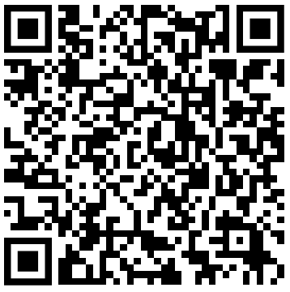
CV Track 2/3:
Transfer Learning, Fine Tuning
https://forms.gle/YG9TtSbimF2bhiUR8
Attendance
Relevant links are inside the form

Slide 2
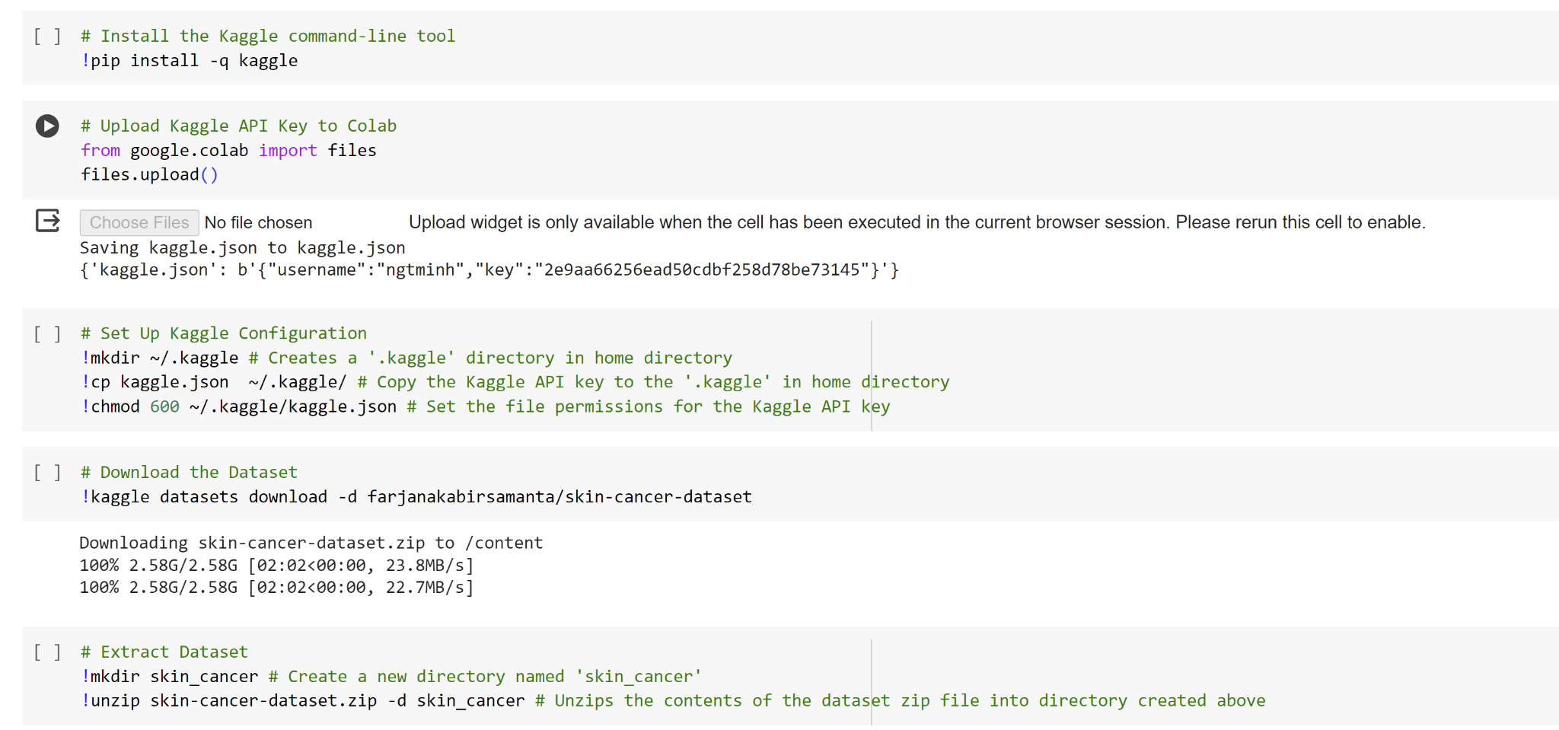
Getting data (Kaggle)

Slide 3
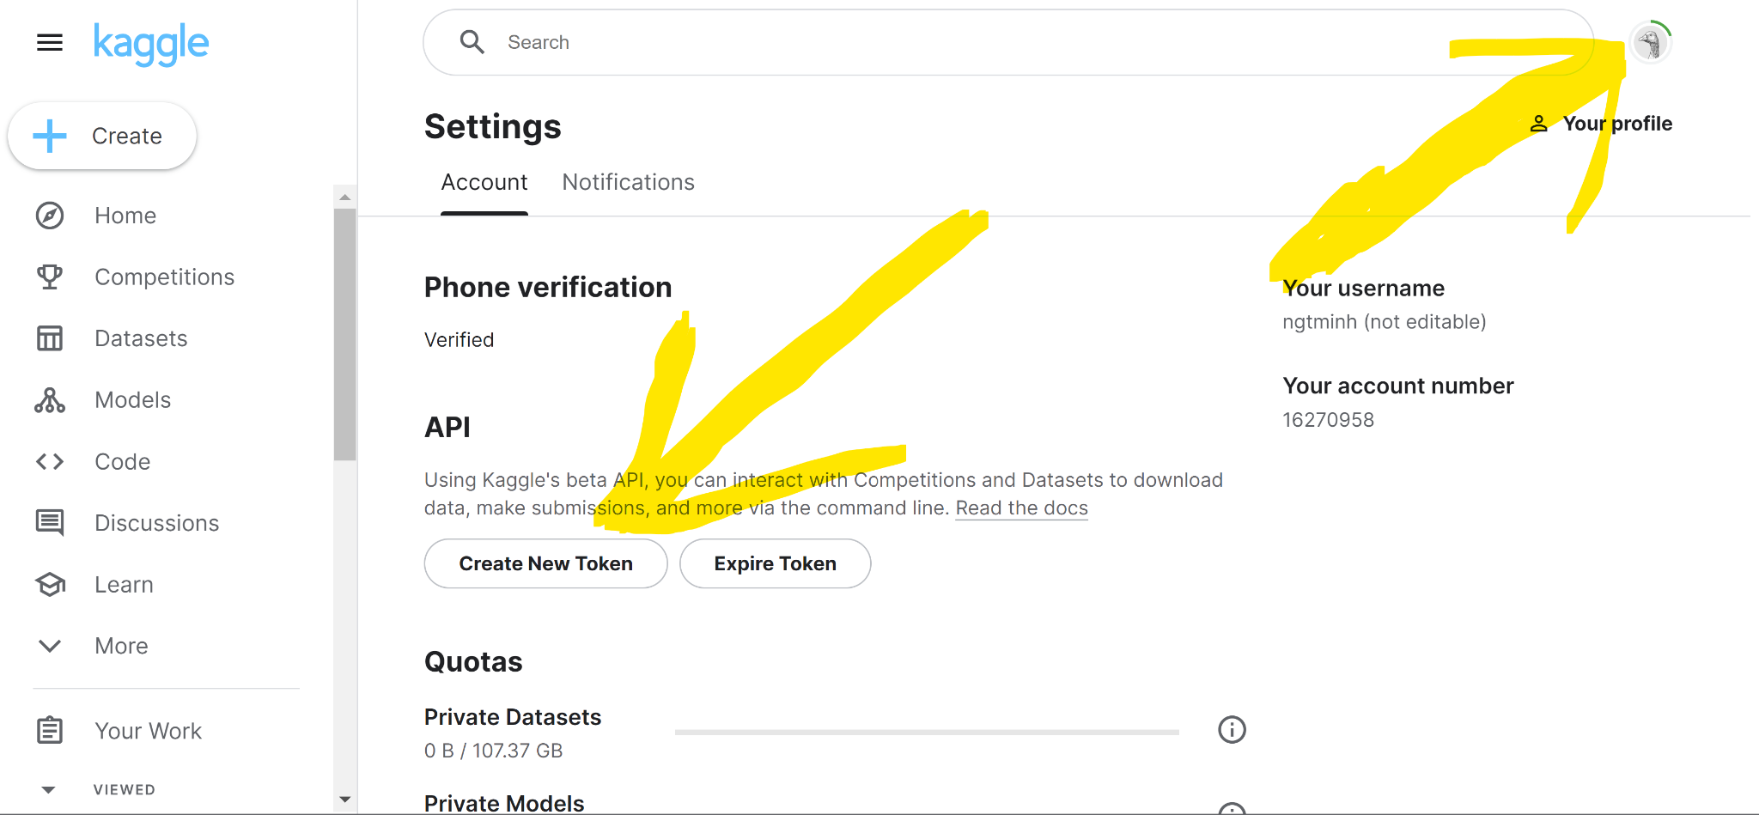
Getting data (Kaggle)

Slide 4

Where can I find pre-trained model?

Slide 5
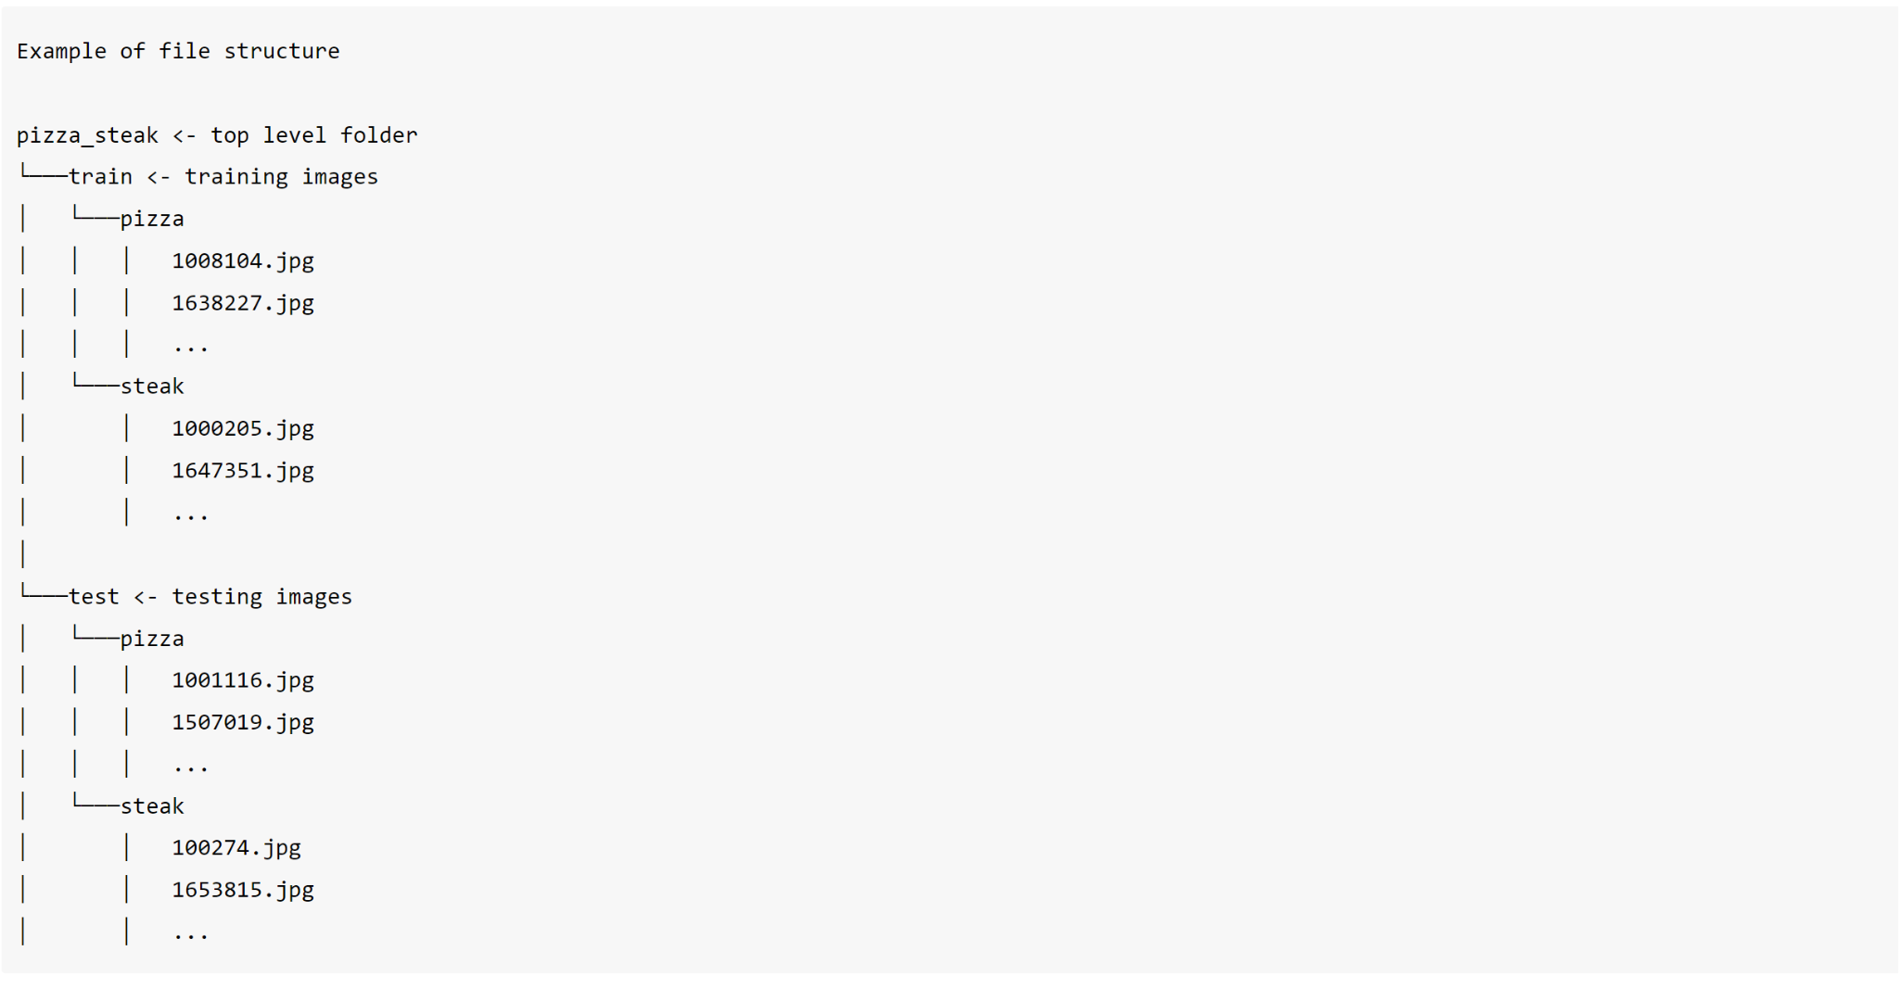
Inspect the data (Food-101: pizza and steak)
Notes:
A very crucial step at the beginning of any machine learning project is becoming one with the data. This usually means plenty of visualizing and folder scanning to understand the data you're working with.
Wtih this being said, let's inspect the data we just downloaded.
The file structure has been formatted to be in a typical format you might use for working with images.
More specifically:
A train directory which contains all of the images in the training dataset with subdirectories each named after a certain class containing images of that class.
A test directory with the same structure as the train directory.

Slide 6
Visualize, visualize, visualize

Slide 7
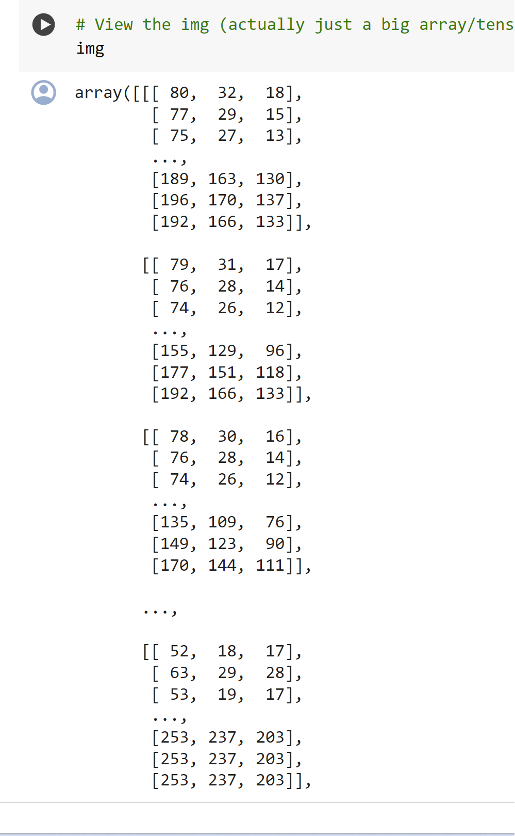
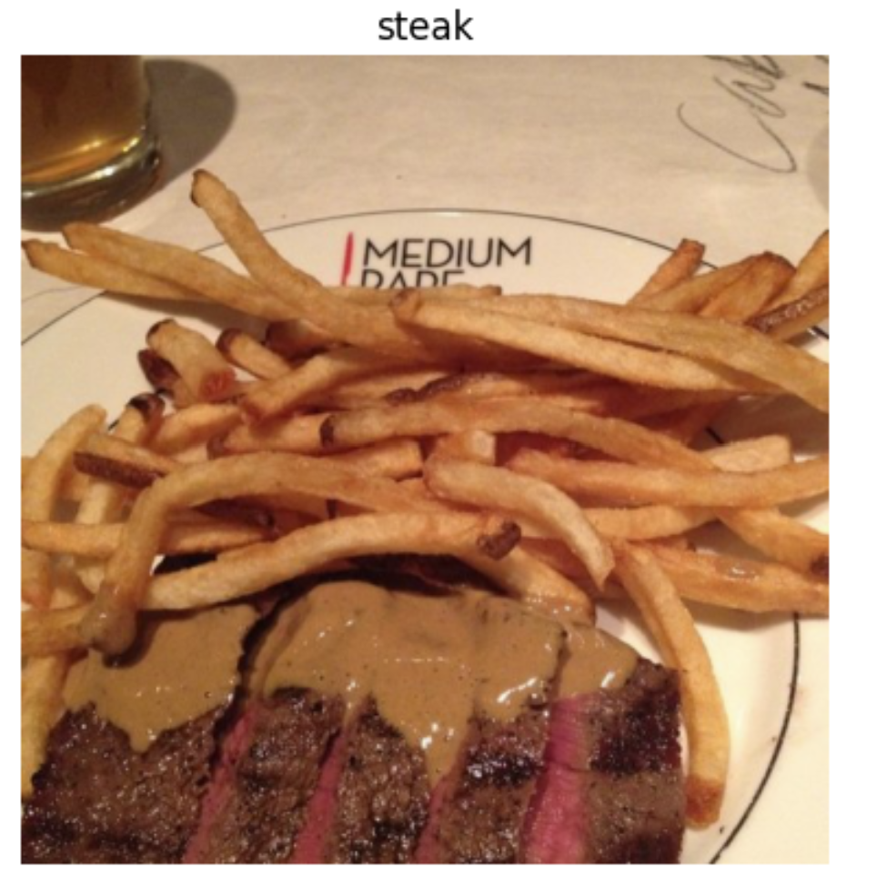
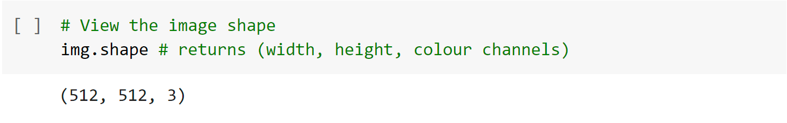
Notes:
You might've noticed we've been printing the image shape alongside the plotted image.
This is because the way our computer sees the image is in the form of a big array (tensor).
Looking at the image shape more closely, you'll see it's in the form (Width, Height, Colour Channels).
In our case, the width and height vary but because we're dealing with colour images, the colour channels value is always 3. This is for different values of red, green and blue (RGB) pixels.
You'll notice all of the values in the img array are between 0 and 255. This is because that's the possible range for red, green and blue values.
For example, a pixel with a value red=0, green=0, blue=255 will look very blue.
So when we build a model to differentiate between our images of pizza and steak, it will be finding patterns in these different pixel values which determine what each class looks like.

Slide 8
Note
Many machine learning models, including neural networks prefer the values they work with to be between 0 and 1. One of the most common preprocessing steps for working with images is to scale (also referred to as normalize) their pixel values by dividing the image arrays by 255.

Slide 9
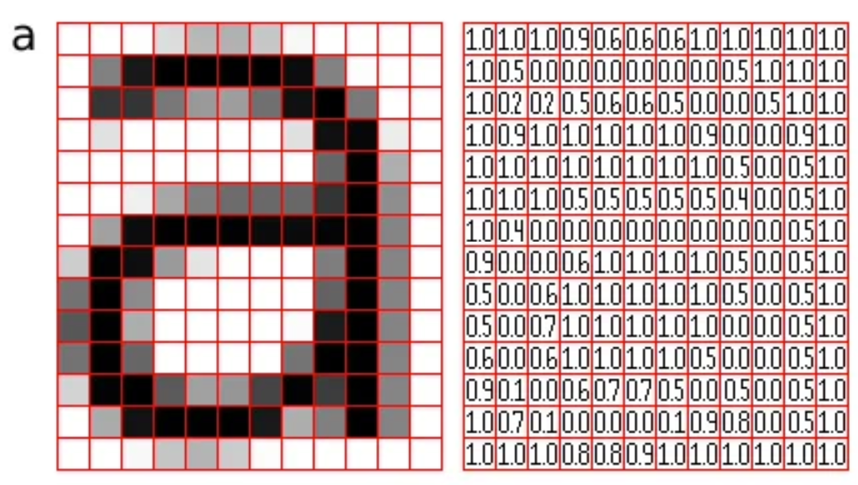
Notes:
What is Convolutional Neural Network?
A Convolutional Neural Network, also known as CNN or ConvNet, is a class of neural networks that specializes in processing data that has a grid-like topology, such as an image. A digital image is a binary representation of visual data. It contains a series of pixels arranged in a grid-like fashion that contains pixel values to denote how bright and what color each pixel should be

Slide 10
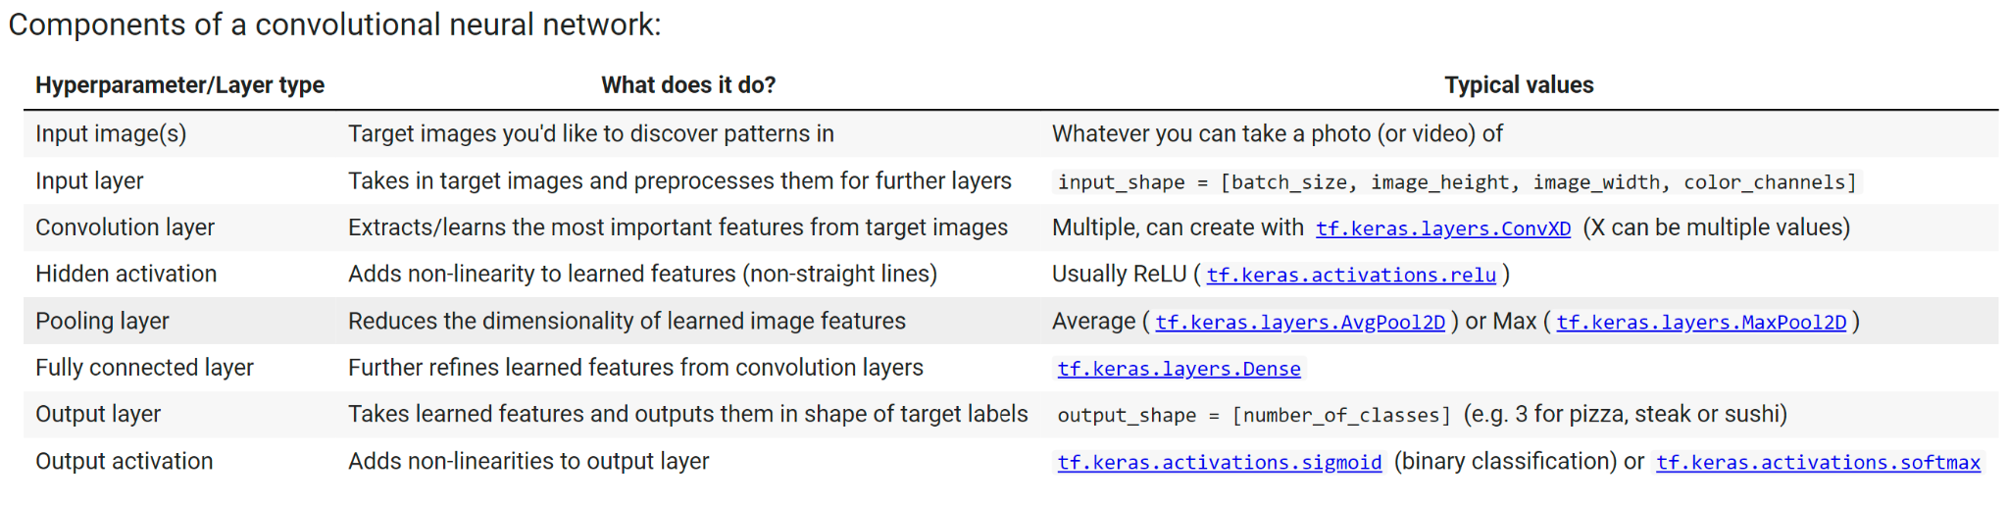
Notes:
Convolutional neural networks are no different to other kinds of deep learning neural networks in the fact they can be created in many different ways. What you see below are some components you'd expect to find in a traditional CNN.

Slide 11
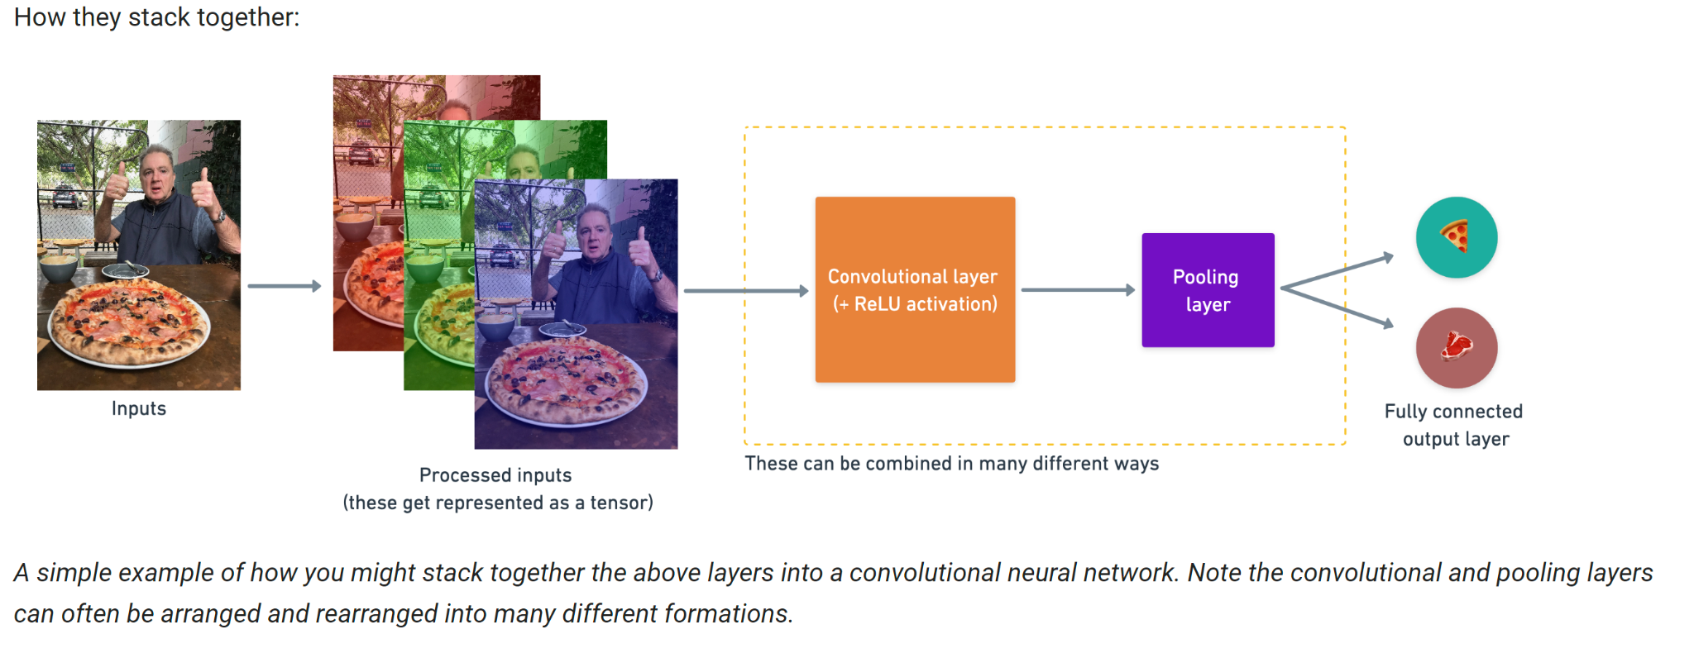

Slide 12
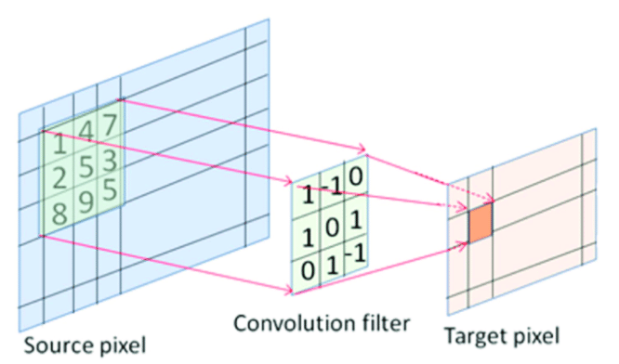
Convolutional layer
Notes:
The convolution layer is the core building block of the CNN. It carries the main portion of the network’s computational load.
This layer performs a dot product between two matrices, where one matrix is the set of learnable parameters otherwise known as a kernel, and the other matrix is the restricted portion of the receptive field. The kernel is spatially smaller than an image but is more in-depth. This means that, if the image is composed of three (RGB) channels, the kernel height and width will be spatially small, but the depth extends up to all three channels.

Slide 13
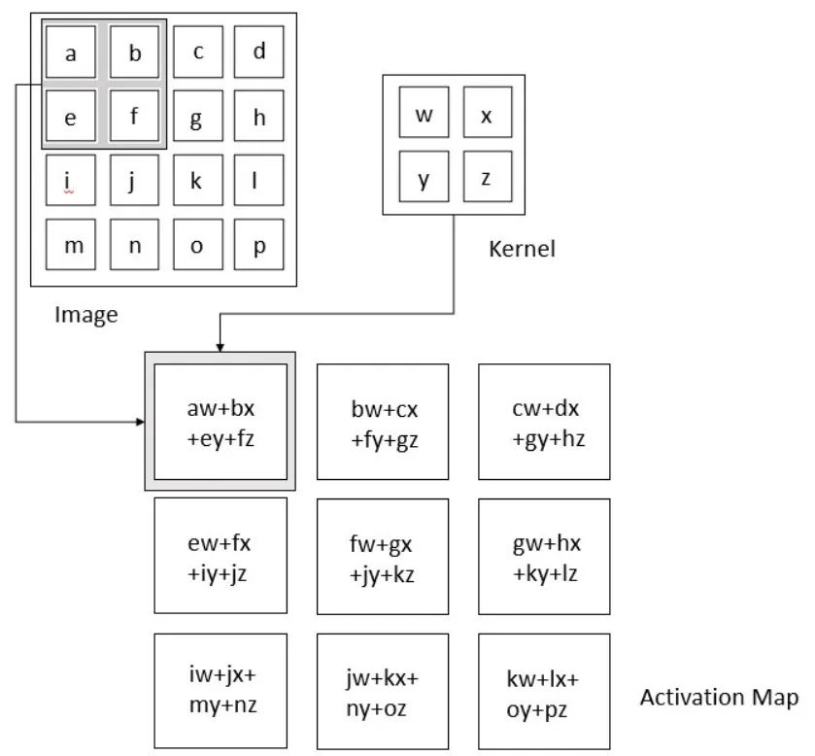
Notes:
During the forward pass, the kernel slides across the height and width of the image-producing the image representation of that receptive region. This produces a two-dimensional representation of the image known as an activation map that gives the response of the kernel at each spatial position of the image. The sliding size of the kernel is called a stride

Slide 14
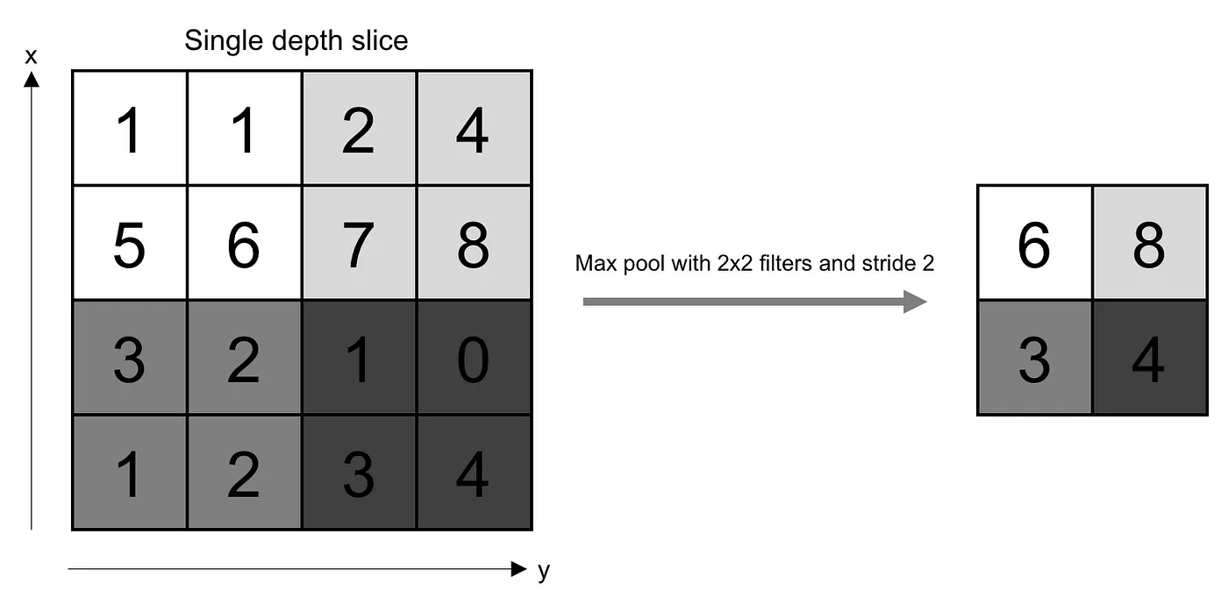
Pooling layer
Notes:
The pooling layer replaces the output of the network at certain locations by deriving a summary statistic of the nearby outputs.
The most popular process is max pooling, which reports the maximum output from the neighborhood.
By downsampling the input, max pooling significantly reduces the number of parameters and computations in the network, thus speeding up the learning process and reducing the risk of overfitting. Noise Suppression: Max pooling helps to suppress noise in the input data.

Slide 15
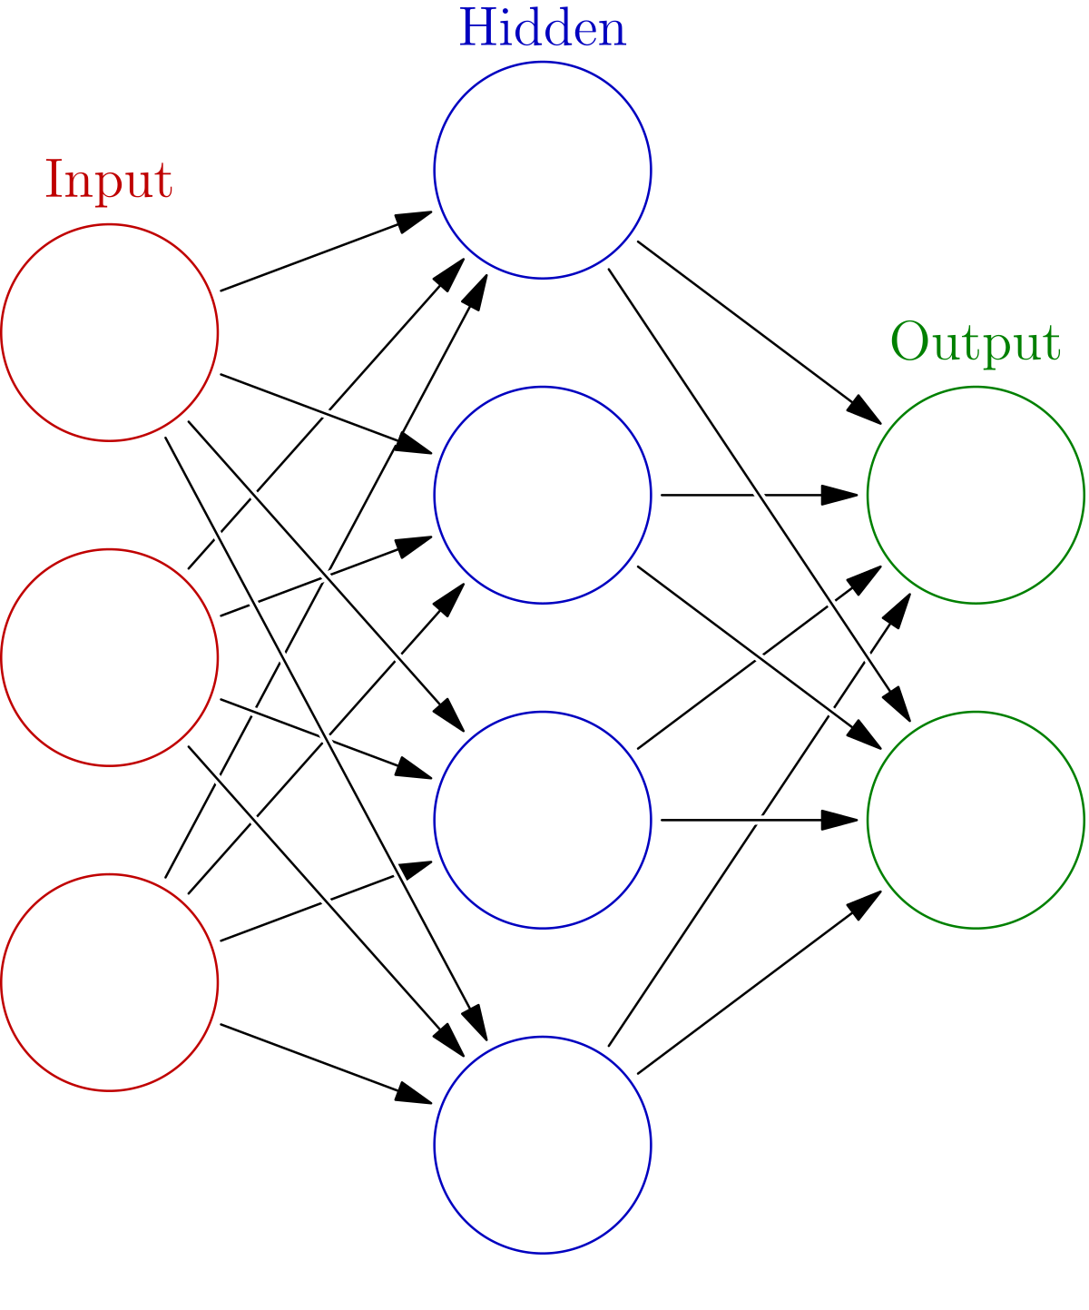
Fully connected Layer (Dense layer)
Since convolution is a linear operation and images are far from linear, non-linearity layers are often placed directly after the convolutional layer to introduce non-linearity to the activation map.
There are several types of non-linear operations, the popular ones being:
1. Sigmoid
2. Relu
3. Tanh
...

Slide 16
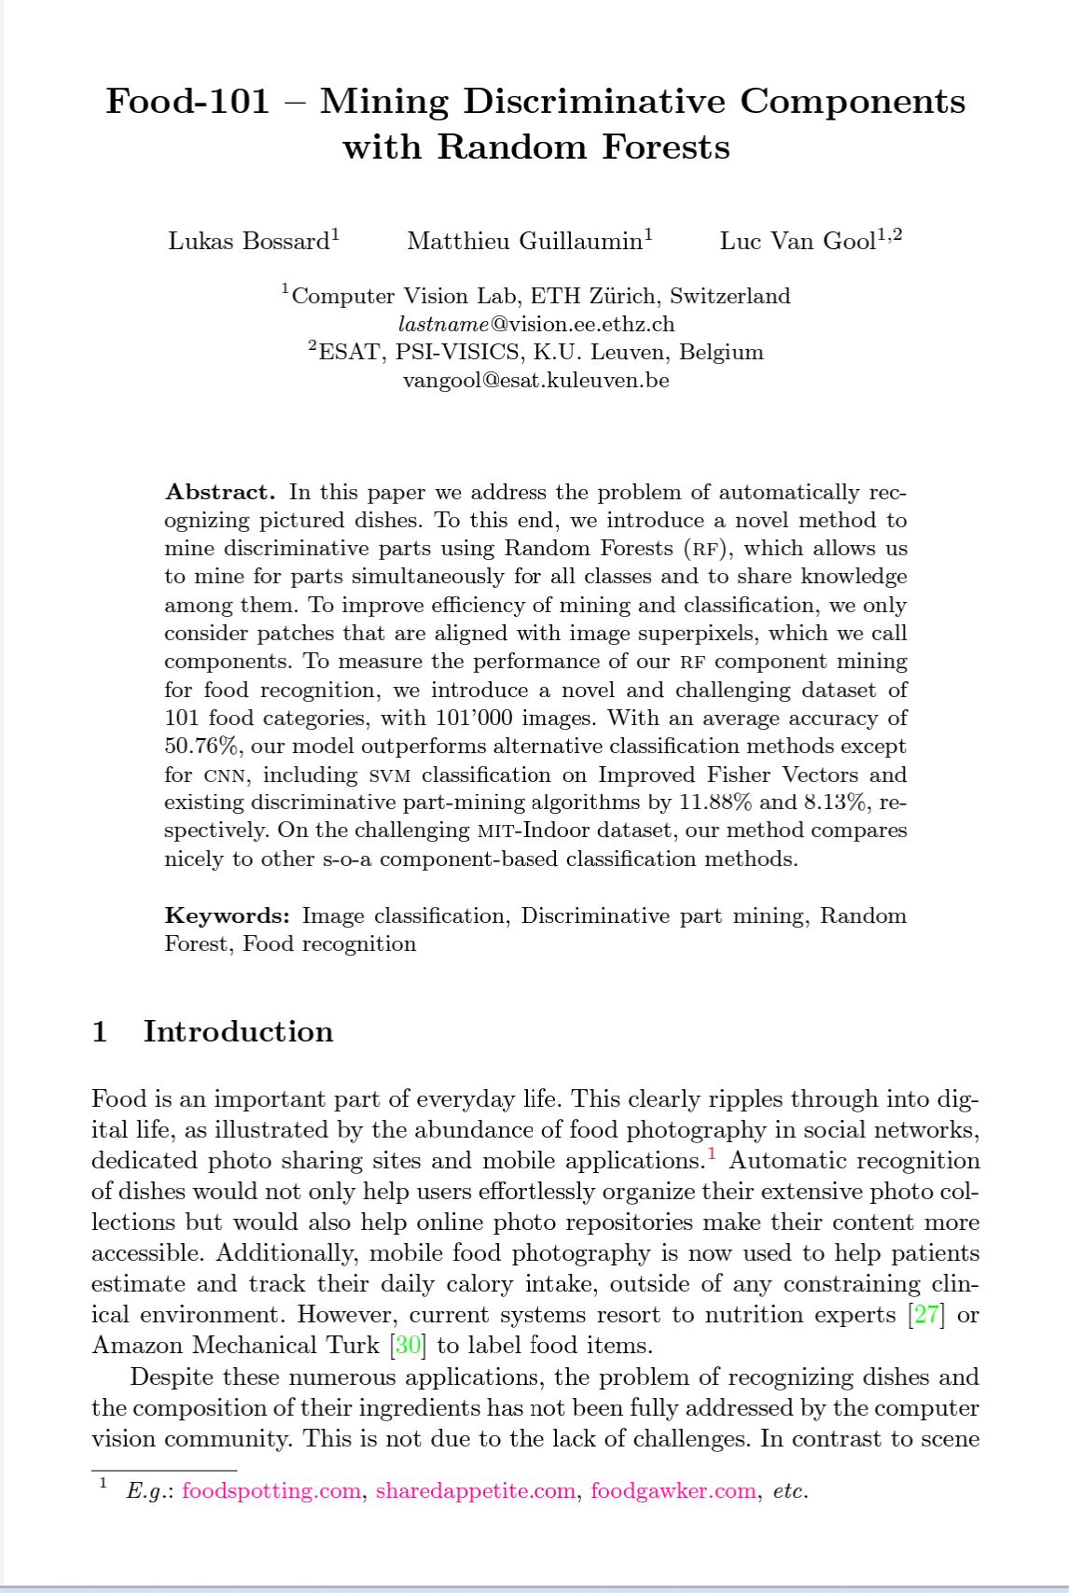
End to end example
Reading the original dataset authors paper, we see they used a Random Forest machine learning model and averaged 50.76% accuracy at predicting what different foods different images had in them.
From now on, that 50.76% will be our baseline.
For reference, the model we're using replicates TinyVGG, the computer vision architecture which fuels the CNN explainer webpage.
Notes:
We've checked out our data and found there's 750 training images, as well as 250 test images per class and they're all of various different shapes.
It's time to jump straight in the deep end.
Reading the original dataset authors paper, we see they used a Random Forest machine learning model and averaged 50.76% accuracy at predicting what different foods different images had in them.
From now on, that 50.76% will be our baseline.
🔑 Note: A baseline is a score or evaluation metric you want to try and beat. Usually you'll start with a simple model, create a baseline and try to beat it by increasing the complexity of the model. A really fun way to learn machine learning is to find some kind of modelling paper with a published result and try to beat it.
The code in the following cell replicates and end-to-end way to model our pizza_steak dataset with a convolutional neural network (CNN) using the components listed above.
There will be a bunch of things you might not recognize but step through the code yourself and see if you can figure out what it's doing.
We'll go through each of the steps later on in the notebook.
For reference, the model we're using replicates TinyVGG, the computer vision architecture which fuels the CNN explainer webpage.

Slide 17
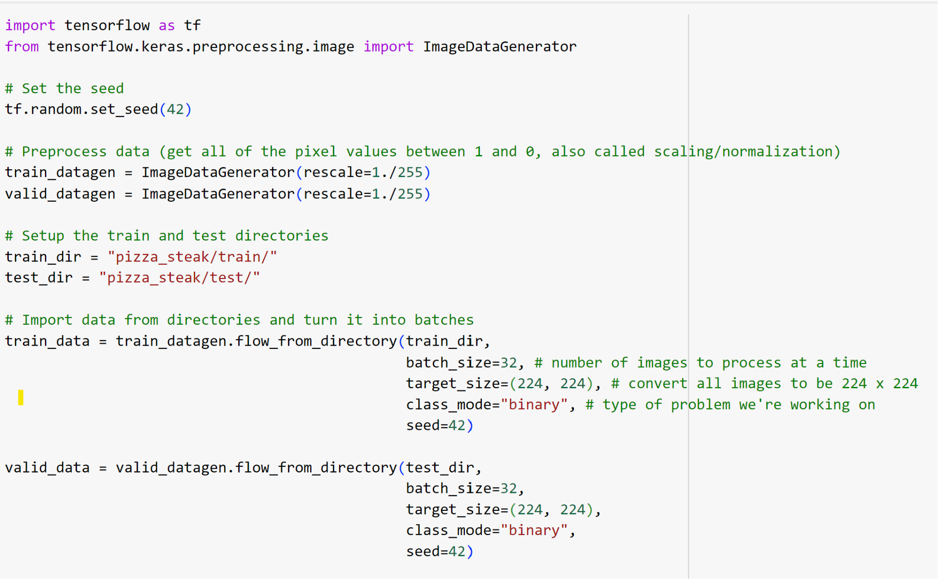

Slide 18
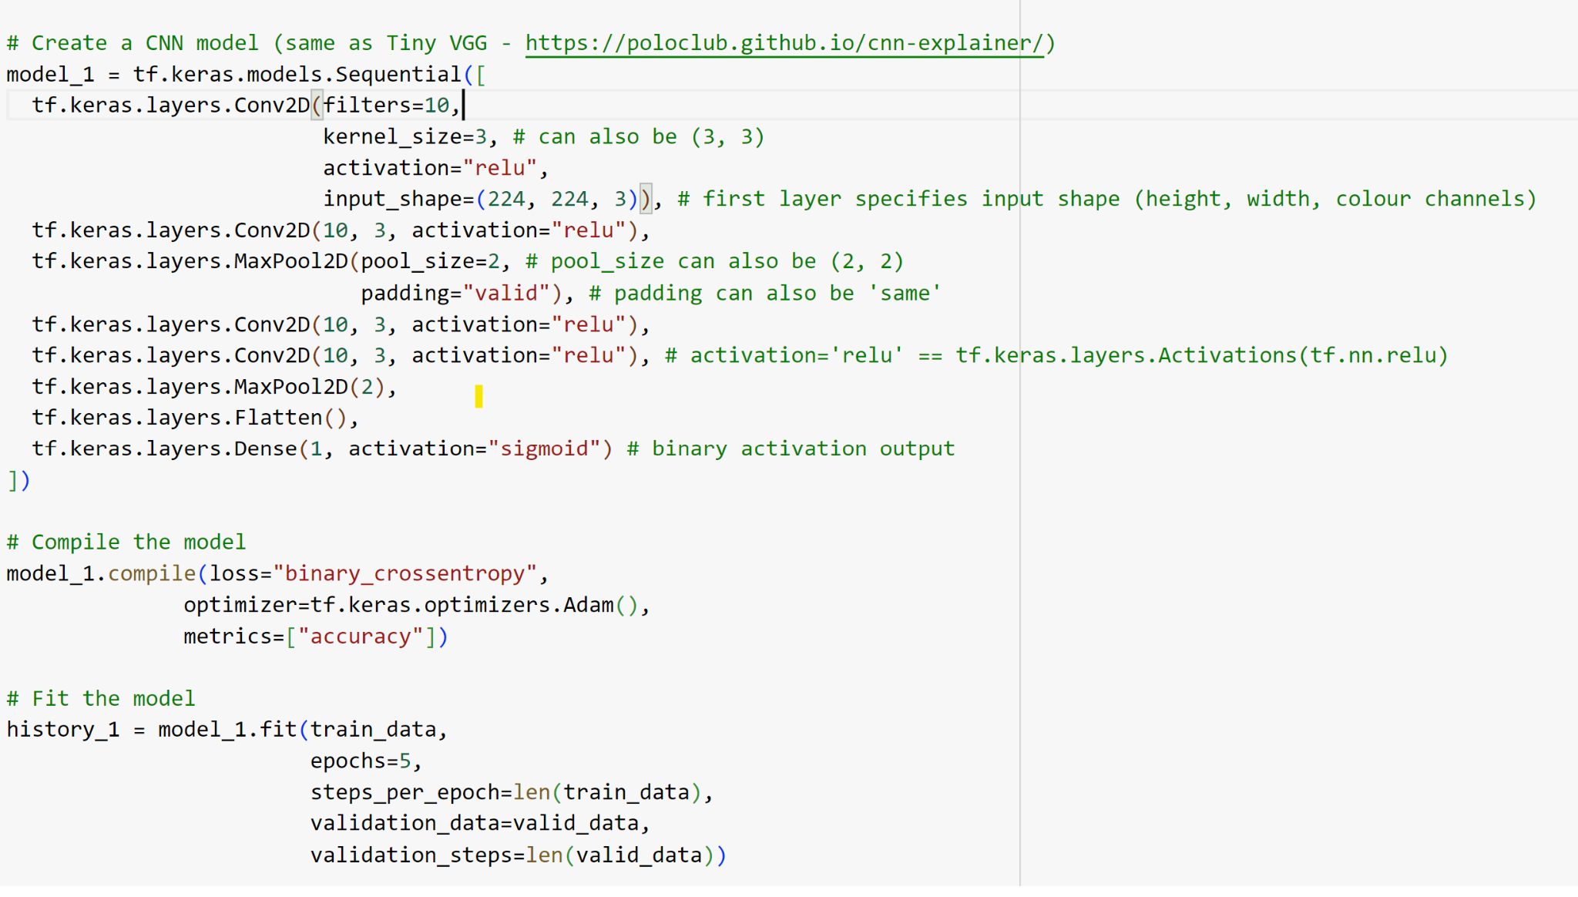
Notes:
Now there are a few new things here we haven't discussed, namely:
The ImageDataGenerator class and the rescale parameter
The flow_from_directory() method
The batch_size parameter: It is the hyperparameter that defines the number of samples to work through before updating the internal model parameters
The target_size parameter
Conv2D layers (and the parameters which come with them)
MaxPool2D layers (and their parameters).
The steps_per_epoch and validation_steps parameters in the fit() function

Slide 19
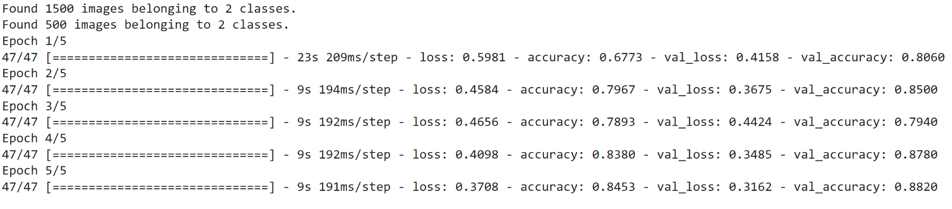
Notes:
After 5 epochs, our model beat the baseline score of 50.76% accuracy (our model got ~85% accuaracy on the training set and ~85% accuracy on the test set).
However, our model only went through a binary classificaiton problem rather than all of the 101 classes in the Food101 dataset, so we can't directly compare these metrics. That being said, the results so far show that our model is learning something.
Note: If the cell above takes more than ~12 seconds per epoch to run, you might not be using a GPU accelerator. If you're using a Colab notebook, you can access a GPU accelerator by going to Runtime -> Change Runtime Type -> Hardware Accelerator and select "GPU". After doing so, you might have to rerun all of the above cells as changing the runtime type causes Colab to have to reset.

Slide 20
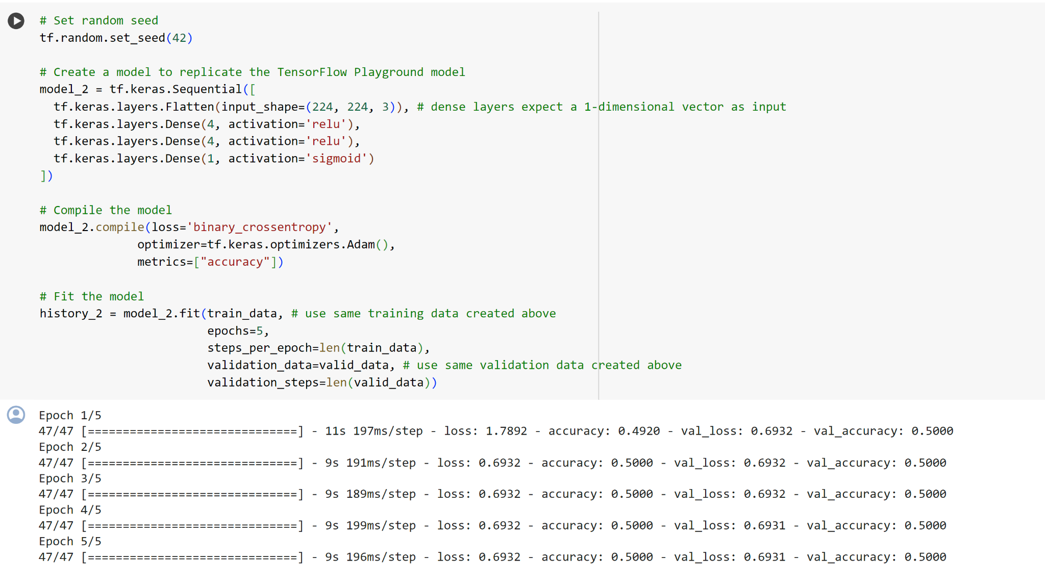
Notes:
Lets check out a normal neural network model and see how its work with the same dataset we use
our model ran but it doesn't seem like it learned anything. It only reaches 50% accuracy on the training and test sets which in a binary classification problem is as good as guessing.
Let's see the architecture.

Slide 21
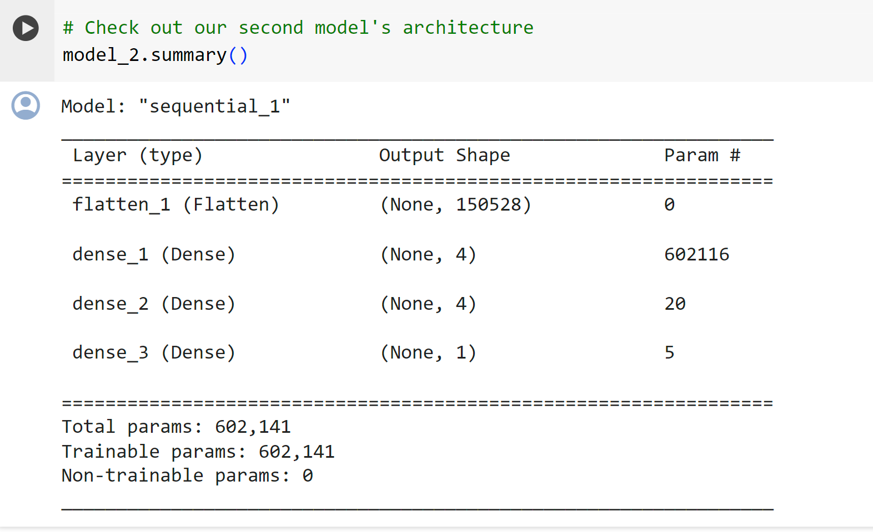
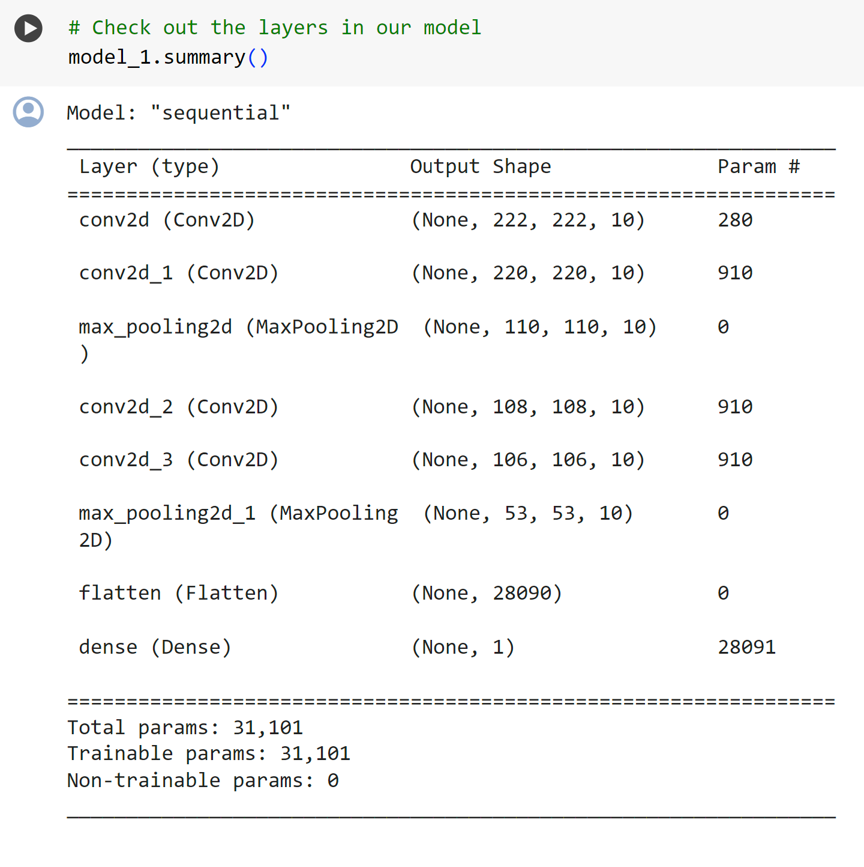
Notes:
One of the most noticeable things here is the much larger number of parameters in model_2 versus model_1.
model_2 has 602,141 trainable parameters where as model_1 has only 31,101. And despite this difference, model_1 still far and large out performs model_2.
You can think of trainable parameters as patterns a model can learn from data. Intuitiely, you might think more is better. And in some cases it is. But in this case, the difference here is in the two different styles of model we're using. Where a series of dense layers have a number of different learnable parameters connected to each other and hence a higher number of possible learnable patterns, a convolutional neural network seeks to sort out and learn the most important patterns in an image. So even though there are less learnable parameters in our convolutional neural network, these are often more helpful in decphering between different features in an image.

Slide 22
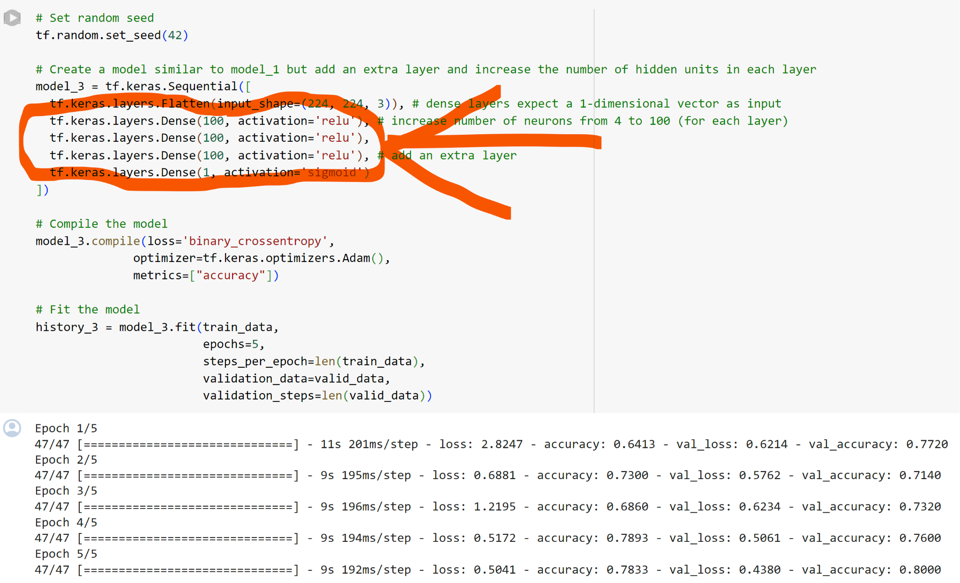
Notes:
So, how about we increase the number of neurons (also called hidden units) in each dense layer from 4 to 100 and add an extra layer.
Looks like our model is learning again. It got ~70% accuracy on the training set and ~70% accuracy on the validation set.
How does the architecute look?

Slide 23
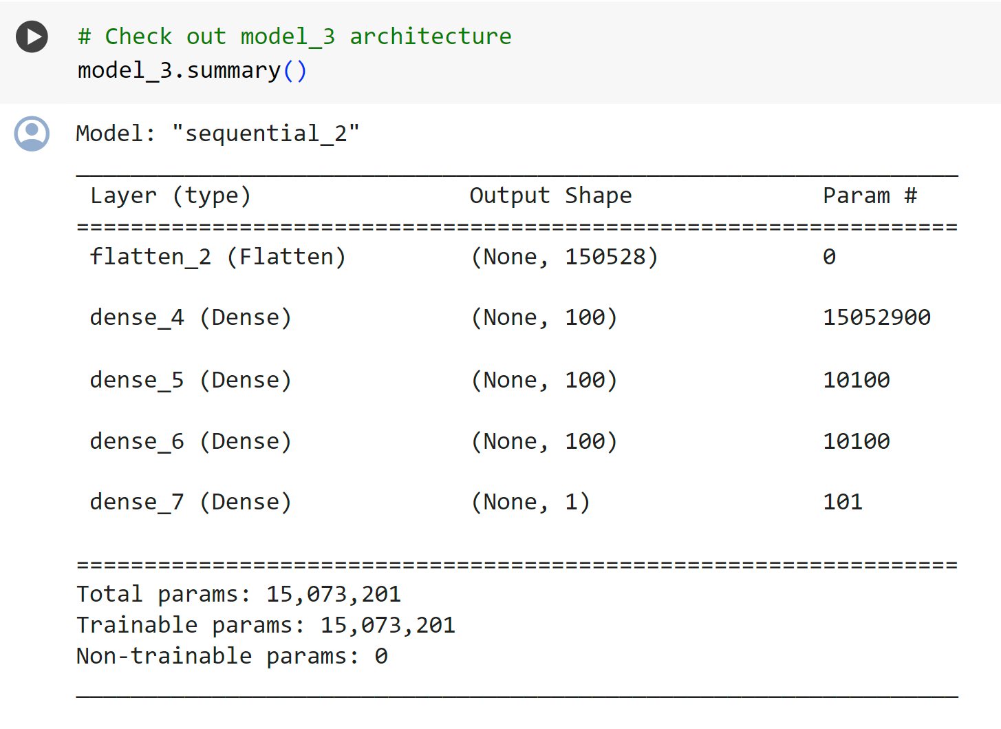
Notes:
The number of trainable parameters has increased even more than model_2. And even with close to 500x (~15,000,000 vs. ~31,000) more trainable parameters, model_3 still doesn't out perform model_1.
This goes to show the power of convolutional neural networks and their ability to learn patterns despite using less parameters.

Slide 24
Binary classification: Let's break it down
We just went through a whirlwind of steps:
Become one with the data (visualize, visualize, visualize...)
Preprocess the data (prepare it for a model)
Create a model (start with a baseline)
Fit the model
Evaluate the model
Adjust different parameters and improve model (try to beat your baseline)
Repeat until satisfied
Let's step through each

Slide 25
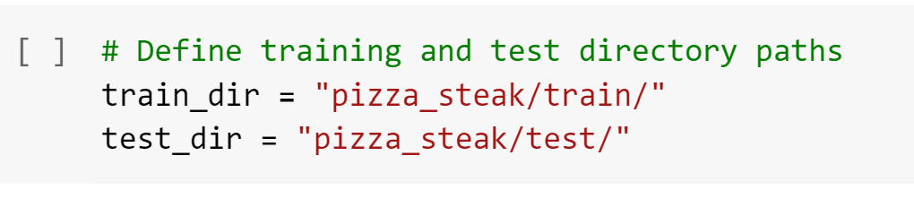
2. Preprocessing the data
One of the most important steps for a machine learning project is creating a training and test set.
In our case, our data is already split into training and test sets. Another option here might be to create a validation set as well, but we'll leave that for now.
For an image classification project, it's standard to have your data seperated into train and test directories with subfolders in each for each class.
To start we define the training and test directory paths.

Slide 26
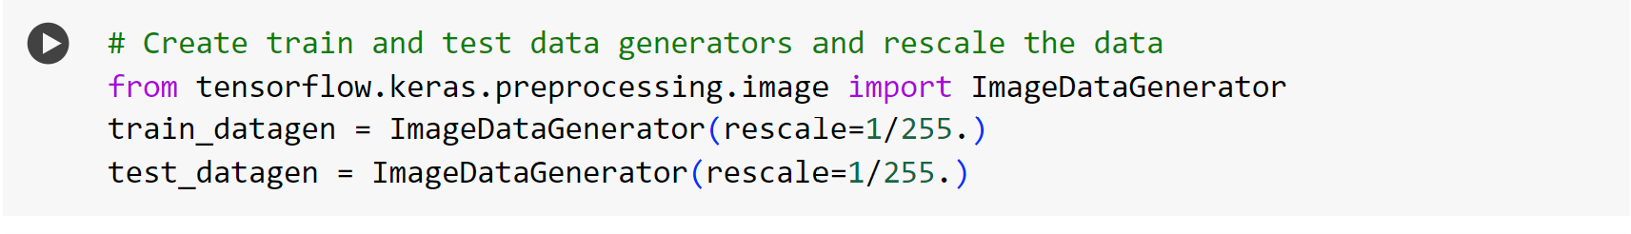
A batch is a small subset of the dataset a model looks at during training. For example, rather than looking at 10,000 images at one time and trying to figure out the patterns, a model might only look at 32 images at a time.
It does this for a couple of reasons:
10,000 images (or more) might not fit into the memory of your processor (GPU).
Trying to learn the patterns in 10,000 images in one hit could result in the model not being able to learn very well.
Notes:
The ImageDataGenerator class helps us prepare our images into batches as well as perform transformations on them as they get loaded into the model.
You might've noticed the rescale parameter. This is one example of the transformations we're doing.
Remember from before how we imported an image and it's pixel values were between 0 and 255?
The rescale parameter, along with 1/255. is like saying "divide all of the pixel values by 255". This results in all of the image being imported and their pixel values being normalized (converted to be between 0 and 1).

Slide 27
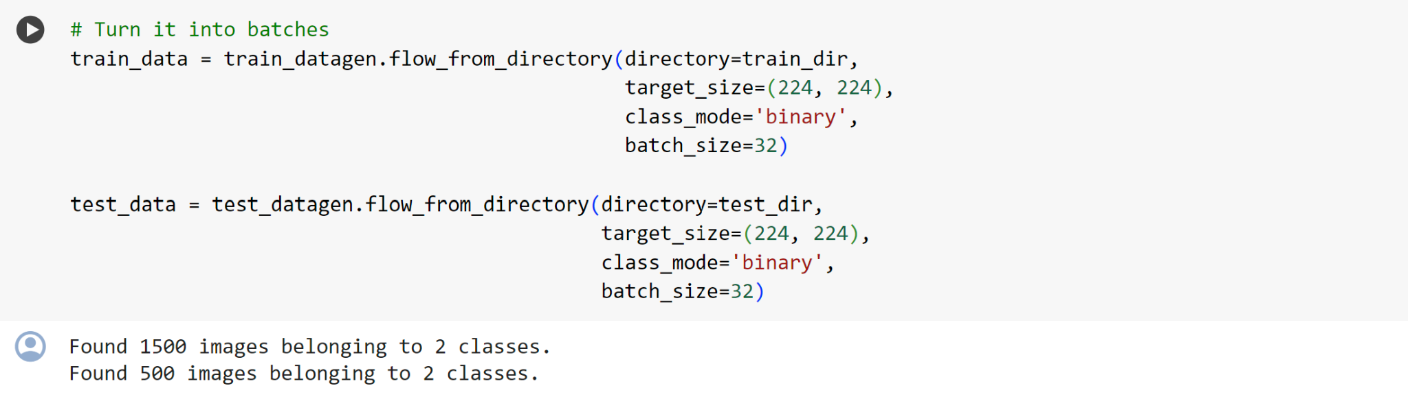
Now we've got a couple of ImageDataGenerator instances, we can load our images from their respective directories using the flow_from_directory method.
Notes:
Looks like our training dataset has 1500 images belonging to 2 classes (pizza and steak) and our test dataset has 500 images also belonging to 2 classes.
Some things to here:
Due to how our directories are structured, the classes get inferred by the subdirectory names in train_dir and test_dir.
The target_size parameter defines the input size of our images in (height, width) format.
The class_mode value of 'binary' defines our classification problem type. If we had more than two classes, we would use 'categorical'.
The batch_size defines how many images will be in each batch, we've used 32 which is the same as the default.
We can take a look at our batched images and labels by inspecting the train_data object.

Slide 28
3. Create a model (start with a baseline)
. A simple heuristic for computer vision models is to use the model architecture which is performing best on ImageNet (a large collection of diverse images to benchmark different computer vision models).
In our case, let's take a smaller version of the model that can be found on the CNN explainer website (model_1 from above) and build a 3 layer convolutional neural network
In deep learning a smaller model often refers to a model with less layers than the state of the art (SOTA). For example, a smaller model might have 3-4 layers where as a state of the art model, such as, ResNet50 might have 50+ layers
Notes:
You might be wondering what your default model architecture should be.
And the truth is, there's many possible answers to this question.
A simple heuristic for computer vision models is to use the model architecture which is performing best on ImageNet (a large collection of diverse images to benchmark different computer vision models).
However, to begin with, it's good to build a smaller model to acquire a baseline result which you try to improve upon.
🔑 Note: In deep learning a smaller model often refers to a model with less layers than the state of the art (SOTA). For example, a smaller model might have 3-4 layers where as a state of the art model, such as, ResNet50 might have 50+ layers.
In our case, let's take a smaller version of the model that can be found on the CNN explainer website (model_1 from above) and build a 3 layer convolutional neural network

Slide 29
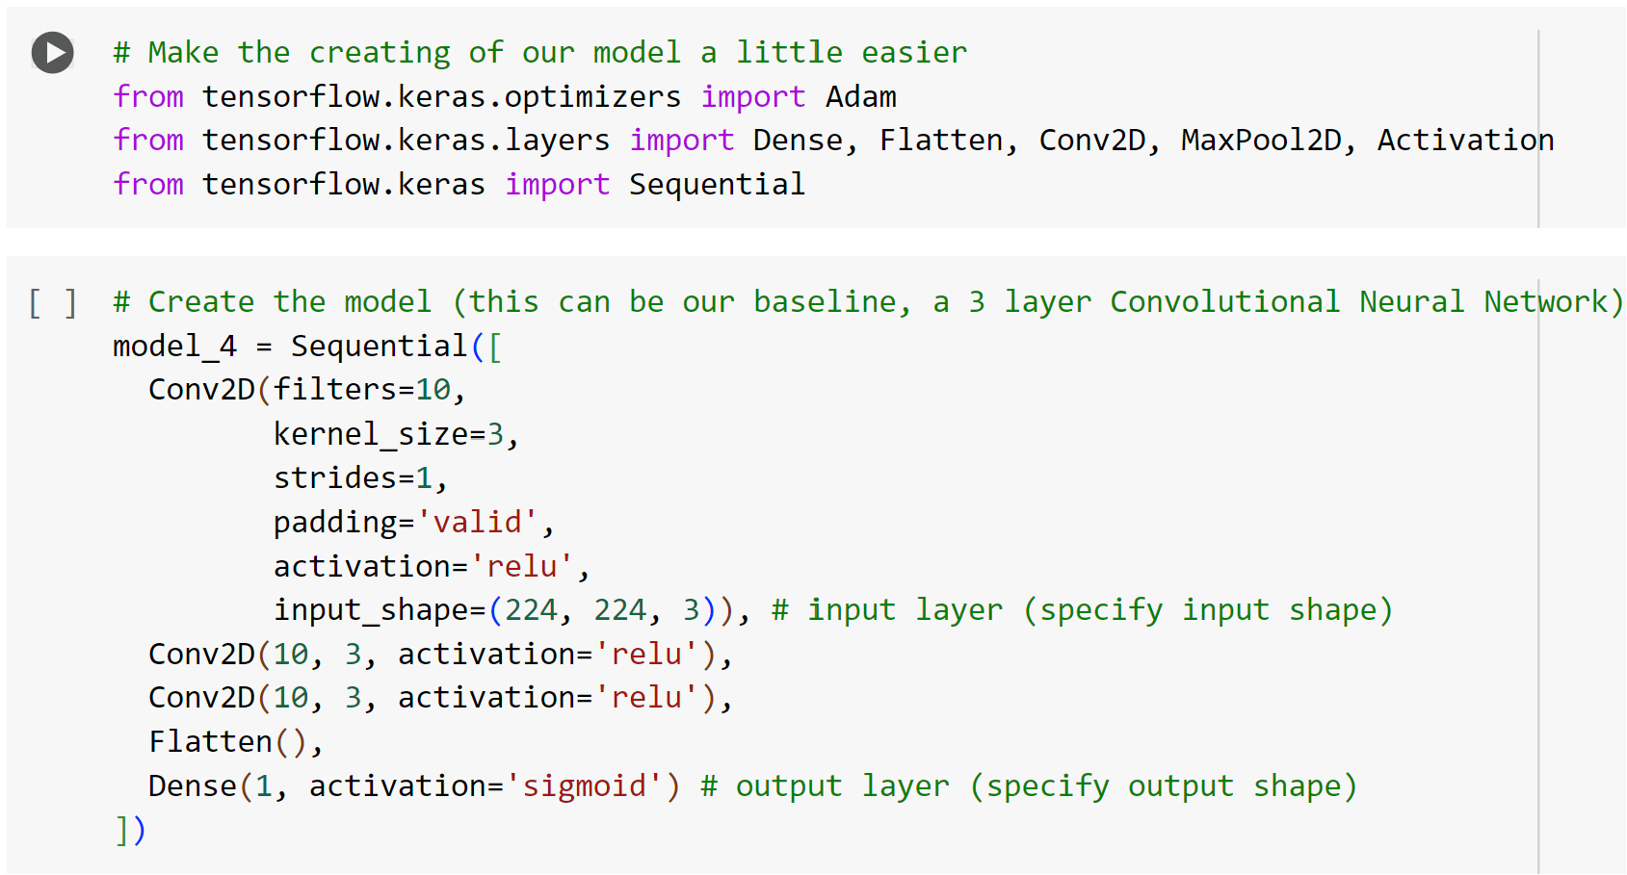
We've got a simple convolutional neural network architecture ready to go.
And it follows the typical CNN structure of:
Input -> Conv + ReLU layers (non-linearities) -> Pooling layer -> Fully connected (dense layer) as Output
Notes:
Input -> Conv + ReLU layers (non-linearities) -> Pooling layer -> Fully connected (dense layer) as Output

Slide 30
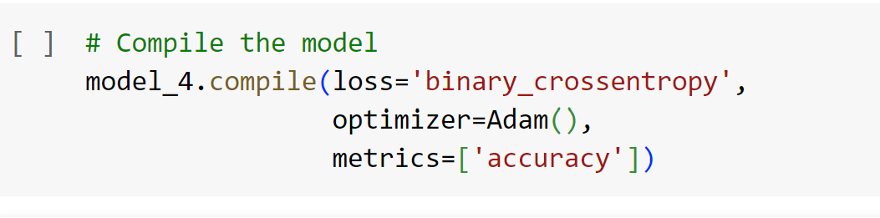
Since we're working on a binary classification problem (pizza vs. steak), the loss function we're using is 'binary_crossentropy', if it was multiclass, we might use something like 'categorical_crossentropy'.
Adam with all the default settings is our optimizer and our evaluation metric is accuracy.

Slide 31
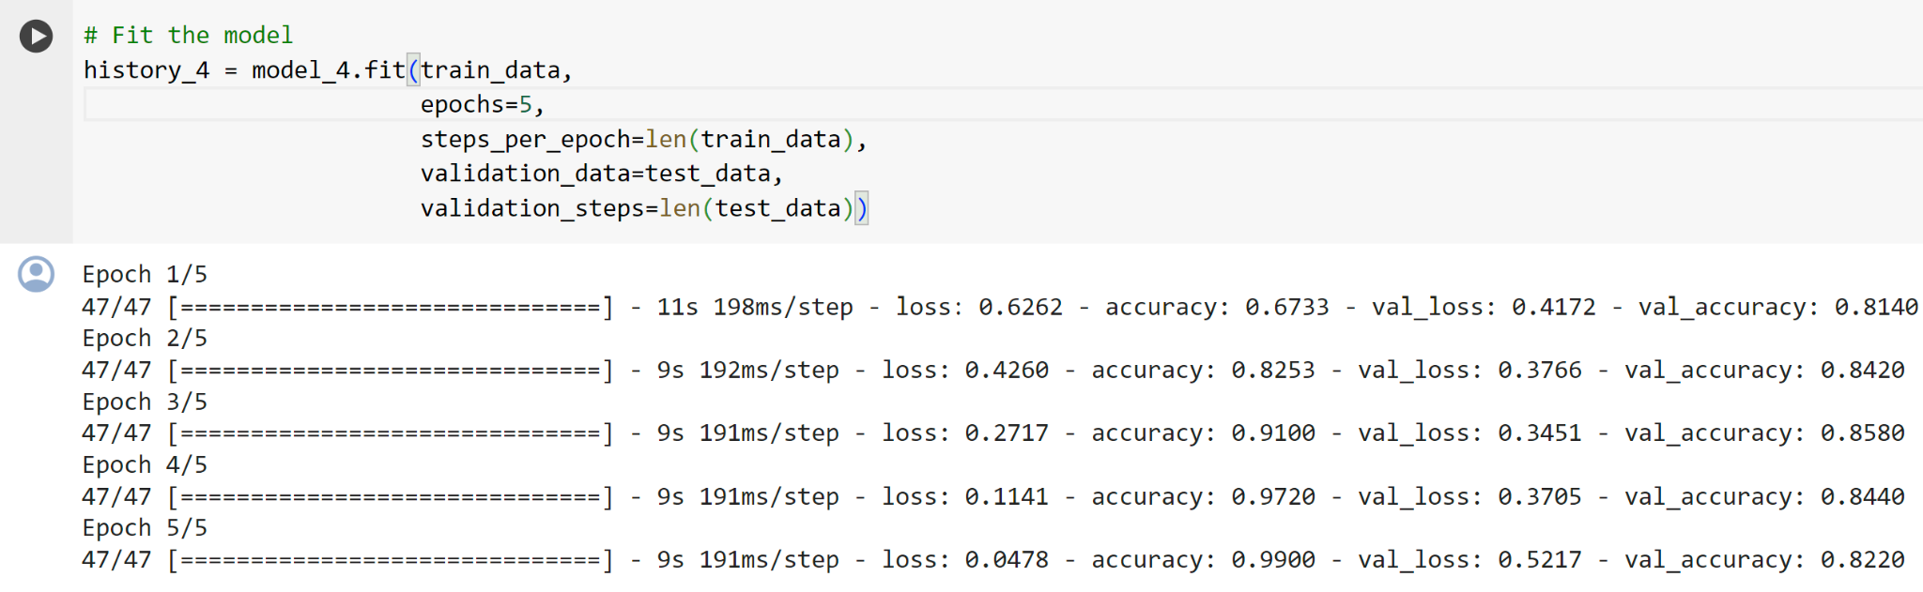
4. Fit a model
Notes:
You'll notice two new parameters here:
steps_per_epoch - this is the number of batches a model will go through per epoch, in our case, we want our model to go through all batches so it's equal to the length of train_data (1500 images in batches of 32 = 1500/32 = ~47 steps)
validation_steps - same as above, except for the validation_data parameter (500 test images in batches of 32 = 500/32 = ~16 steps)

Slide 32
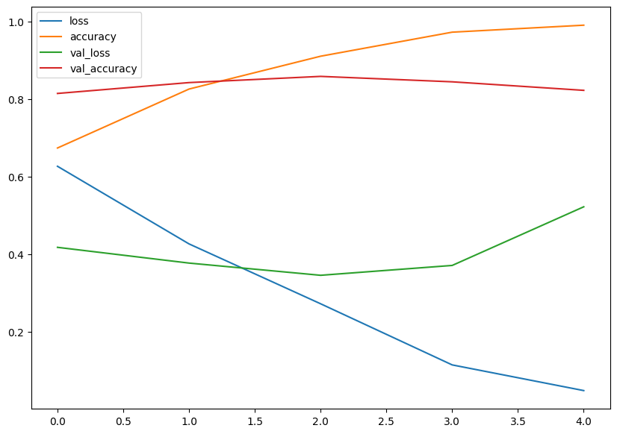
5. Evaluating the model
Notes:
Hmm, judging by our loss curves, it looks like our model is overfitting the training dataset.
🔑 Note: When a model's validation loss starts to increase, it's likely that it's overfitting the training dataset. This means, it's learning the patterns in the training dataset too well and thus its ability to generalize to unseen data will be diminished.
To further inspect our model's training performance, let's separate the accuracy and loss curves.

Slide 33
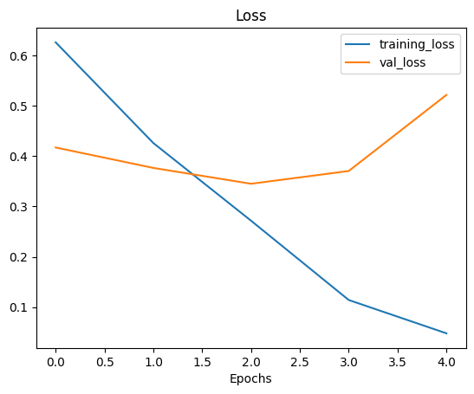
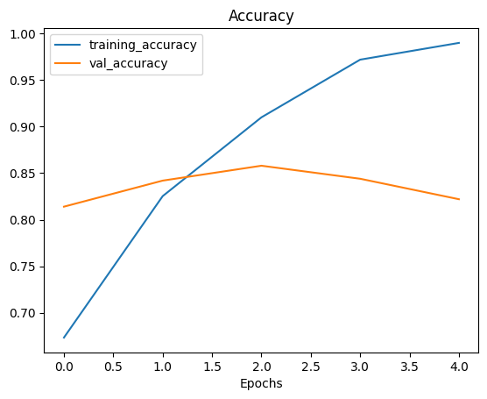
Notes:
The ideal position for these two curves is to follow each other. If anything, the validation curve should be slightly under the training curve. If there's a large gap between the training curve and validation curve, it means your model is probably overfitting.

Slide 34
6. Adjust the model parameters
Fitting a machine learning model comes in 3 steps:
0.Create a basline.
1.Beat the baseline by overfitting a larger model.
2.Reduce overfitting.
So far we've gone through steps 0 and 1.
And there are even a few more things we could try to further overfit our model:
Increase the number of convolutional layers.
Increase the number of convolutional filters.
Add another dense layer to the output of our flattened layer
Notes:
But what we'll do instead is focus on getting our model's training curves to better align with eachother, in other words, we'll take on step 2.
Why is reducing overfitting important?
When a model performs too well on training data and poorly on unseen data, it's not much use to us if we wanted to use it in the real world.
Say we were building a pizza vs. steak food classifier app, and our model performs very well on our training data but when users tried it out, they didn't get very good results on their own food images, is that a good experience?

Slide 35
So for the next few models we build, we're going to adjust a number of parameters and inspect the training curves along the way.
Namely, we'll build 2 more models:
A ConvNet with max pooling
A ConvNet with max pooling and data augmentation
For the first model, we'll follow the modified basic CNN structure:
Input -> Conv layers + ReLU layers (non-linearities) + Max Pooling layers -> Fully connected (dense layer) as Output

Slide 36
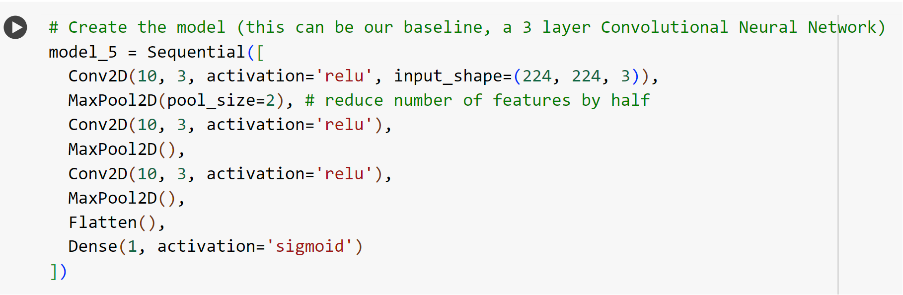
Notes:
we've got another layer type we haven't seen before.
If convolutional layers learn the features of an image you can think of a Max Pooling layer as figuring out the most important of those features. We'll see this an example of this in a moment.

Slide 37
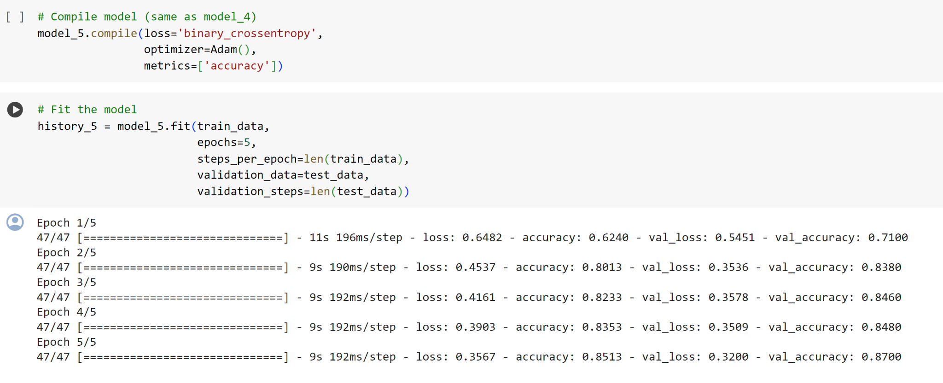
Notes:
it looks like our model with max pooling (model_5) is performing worse on the training set but better on the validation set.
Before we checkout its training curves, let's check out its architecture.

Slide 38
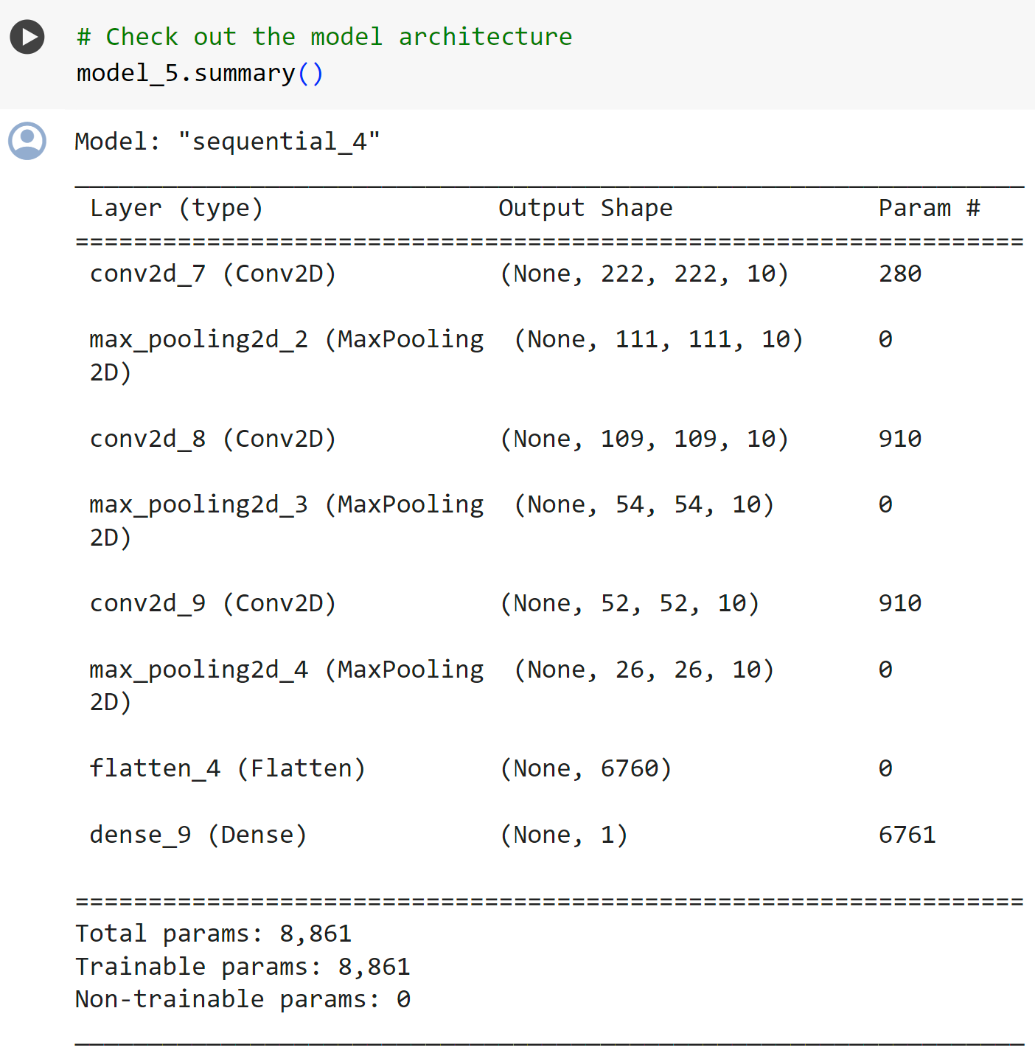
Notes:
Do you notice what's going on here with the output shape in each MaxPooling2D layer?
It gets halved each time. This is effectively the MaxPooling2D layer taking the outputs of each Conv2D layer and saying "I only want the most important features, get rid of the rest".
The bigger the pool_size parameter, the more the max pooling layer will squeeze the features out of the image. However, too big and the model might not be able to learn anything.
The results of this pooling are seen in a major reduction of total trainable parameters (8,861 in model_5 and 477,431 in model_4).
Time to check out the loss curves.

Slide 39
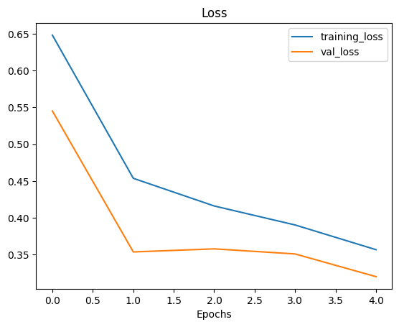
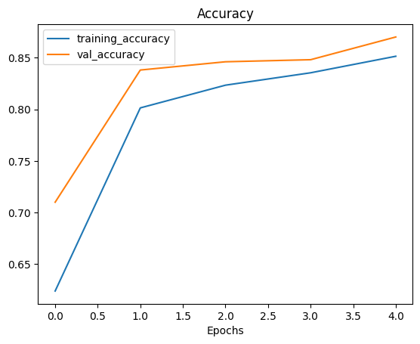
Notes:
We can see the training curves get a lot closer to eachother. However, our the validation loss looks to start increasing towards the end and in turn potentially leading to overfitting.
Time to dig into our bag of tricks and try another method of overfitting prevention, data augmentation.
First, we'll see how it's done with code then we'll discuss what it's doing.

Slide 40
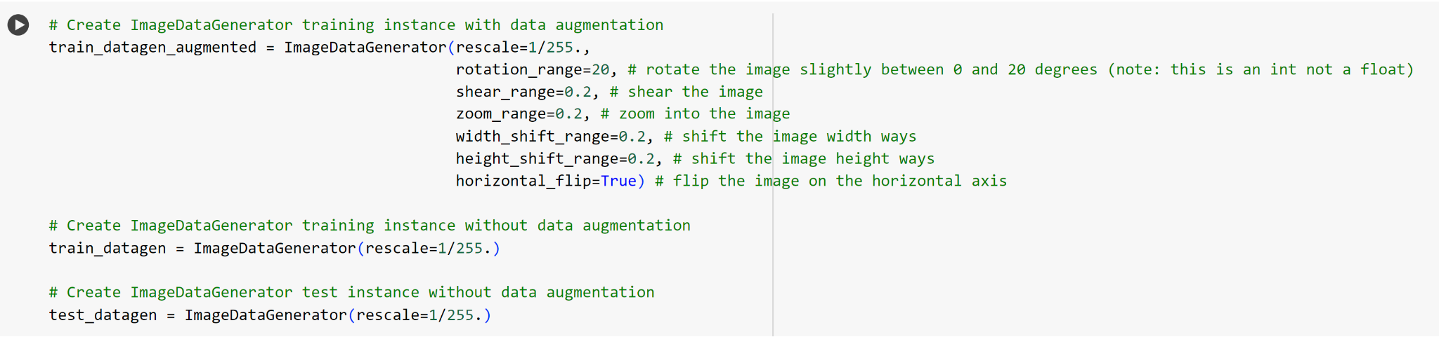
Note: Data augmentation is usually only performed on the training data. Using the ImageDataGenerator built-in data augmentation parameters our images are left as they are in the directories but are randomly manipulated when loaded into the model.
Notes:
To implement data augmentation, we'll have to reinstantiate our ImageDataGenerator instances.
Data augmentation is the process of altering our training data, leading to it having more diversity and in turn allowing our models to learn more generalizable patterns. Altering might mean adjusting the rotation of an image, flipping it, cropping it or something similar.
Doing this simulates the kind of data a model might be used on in the real world.
If we're building a pizza vs. steak application, not all of the images our users take might be in similar setups to our training data. Using data augmentation gives us another way to prevent overfitting and in turn make our model more generalizable.

Slide 41
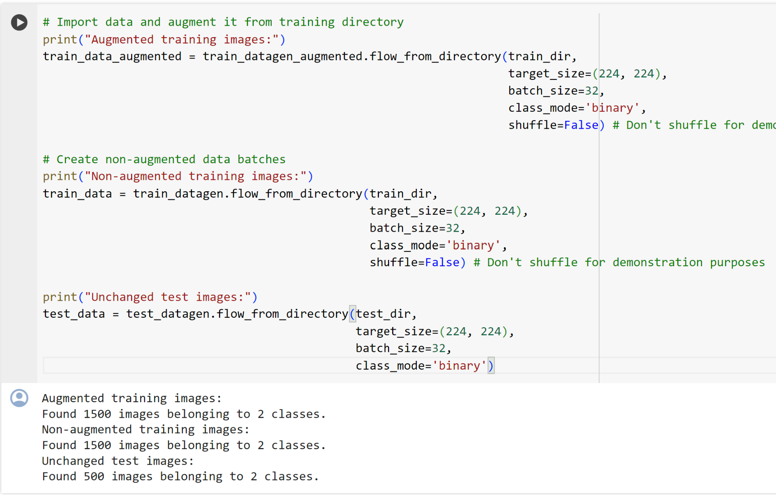

Slide 42
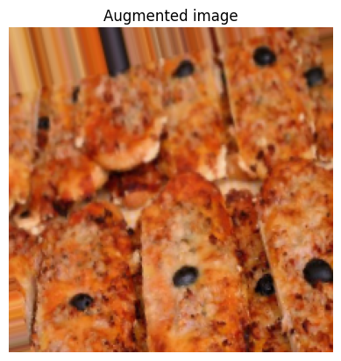
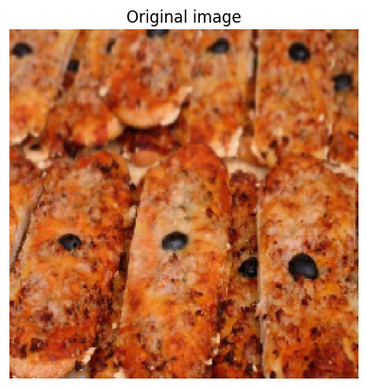
Notes:
After going through a sample of original and augmented images, you can start to see some of the example transformations on the training images.
Notice how some of the augmented images look like slightly warped versions of the original image. This means our model will be forced to try and learn patterns in less-than-perfect images, which is often the case when using real-world images.
🤔 Question: Should I use data augmentation? And how much should I augment?
Data augmentation is a way to try and prevent a model overfitting. If your model is overfiting (e.g. the validation loss keeps increasing), you may want to try using data augmentation.
As for how much to data augment, there's no set practice for this. Best to check out the options in the ImageDataGenerator class and think about how a model in your use case might benefit from some data augmentation.
Now we've got augmented data, let's try and refit a model on it and see how it affects training.

Slide 43
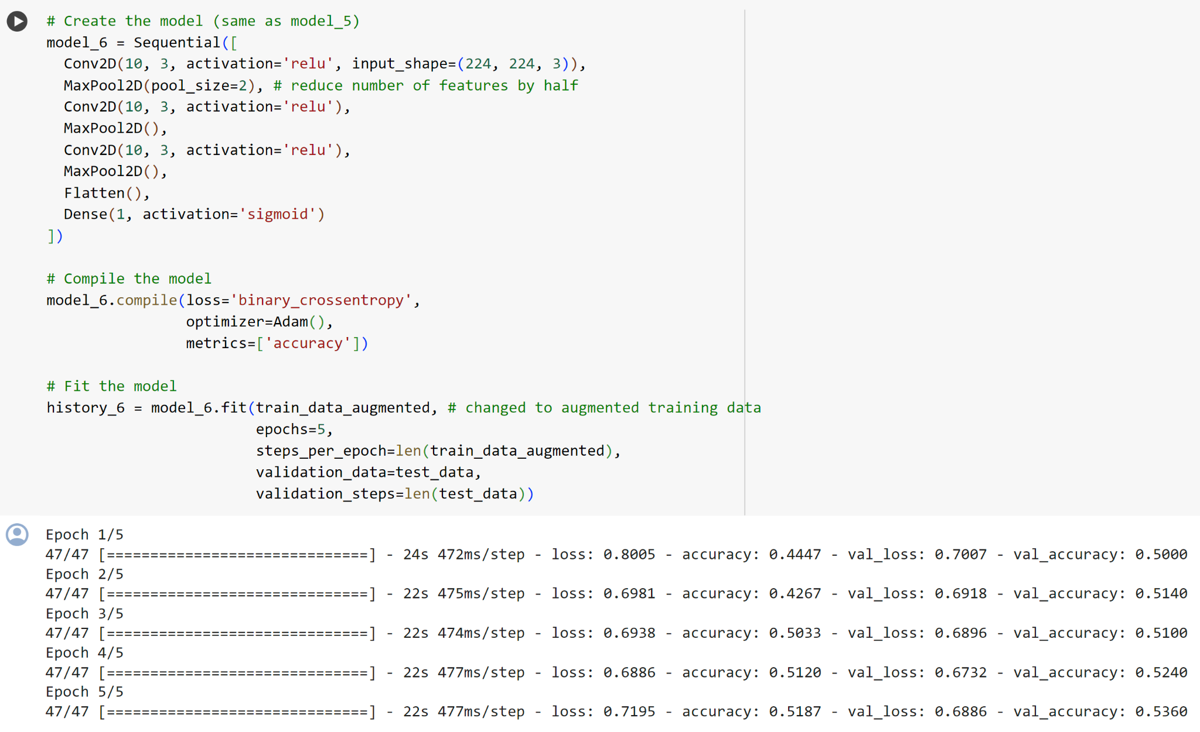
Notes:
It's because when we created train_data_augmented we turned off data shuffling using shuffle=False which means our model only sees a batch of a single kind of images at a time.
For example, the pizza class gets loaded in first because it's the first class. Thus it's performance is measured on only a single class rather than both classes. The validation data performance improves steadily because it contains shuffled data.
Since we only set shuffle=False for demonstration purposes (so we could plot the same augmented and non-augmented image), we can fix this by setting shuffle=True on future data generators.
You may have also noticed each epoch taking longer when training with augmented data compared to when training with non-augmented data (~25s per epoch vs. ~10s per epoch).
This is because the ImageDataGenerator instance augments the data as it's loaded into the model. The benefit of this is that it leaves the original images unchanged. The downside is that it takes longer to load them in.

Slide 44
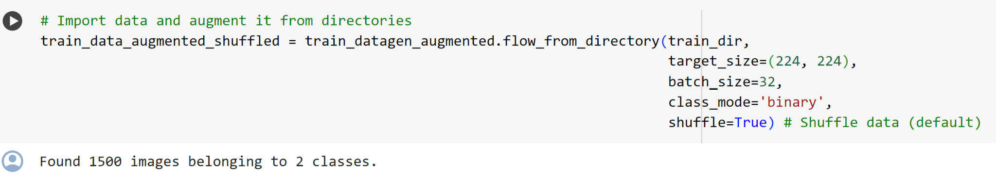
Let's see what happens when we shuffle the augmented training data

Slide 45
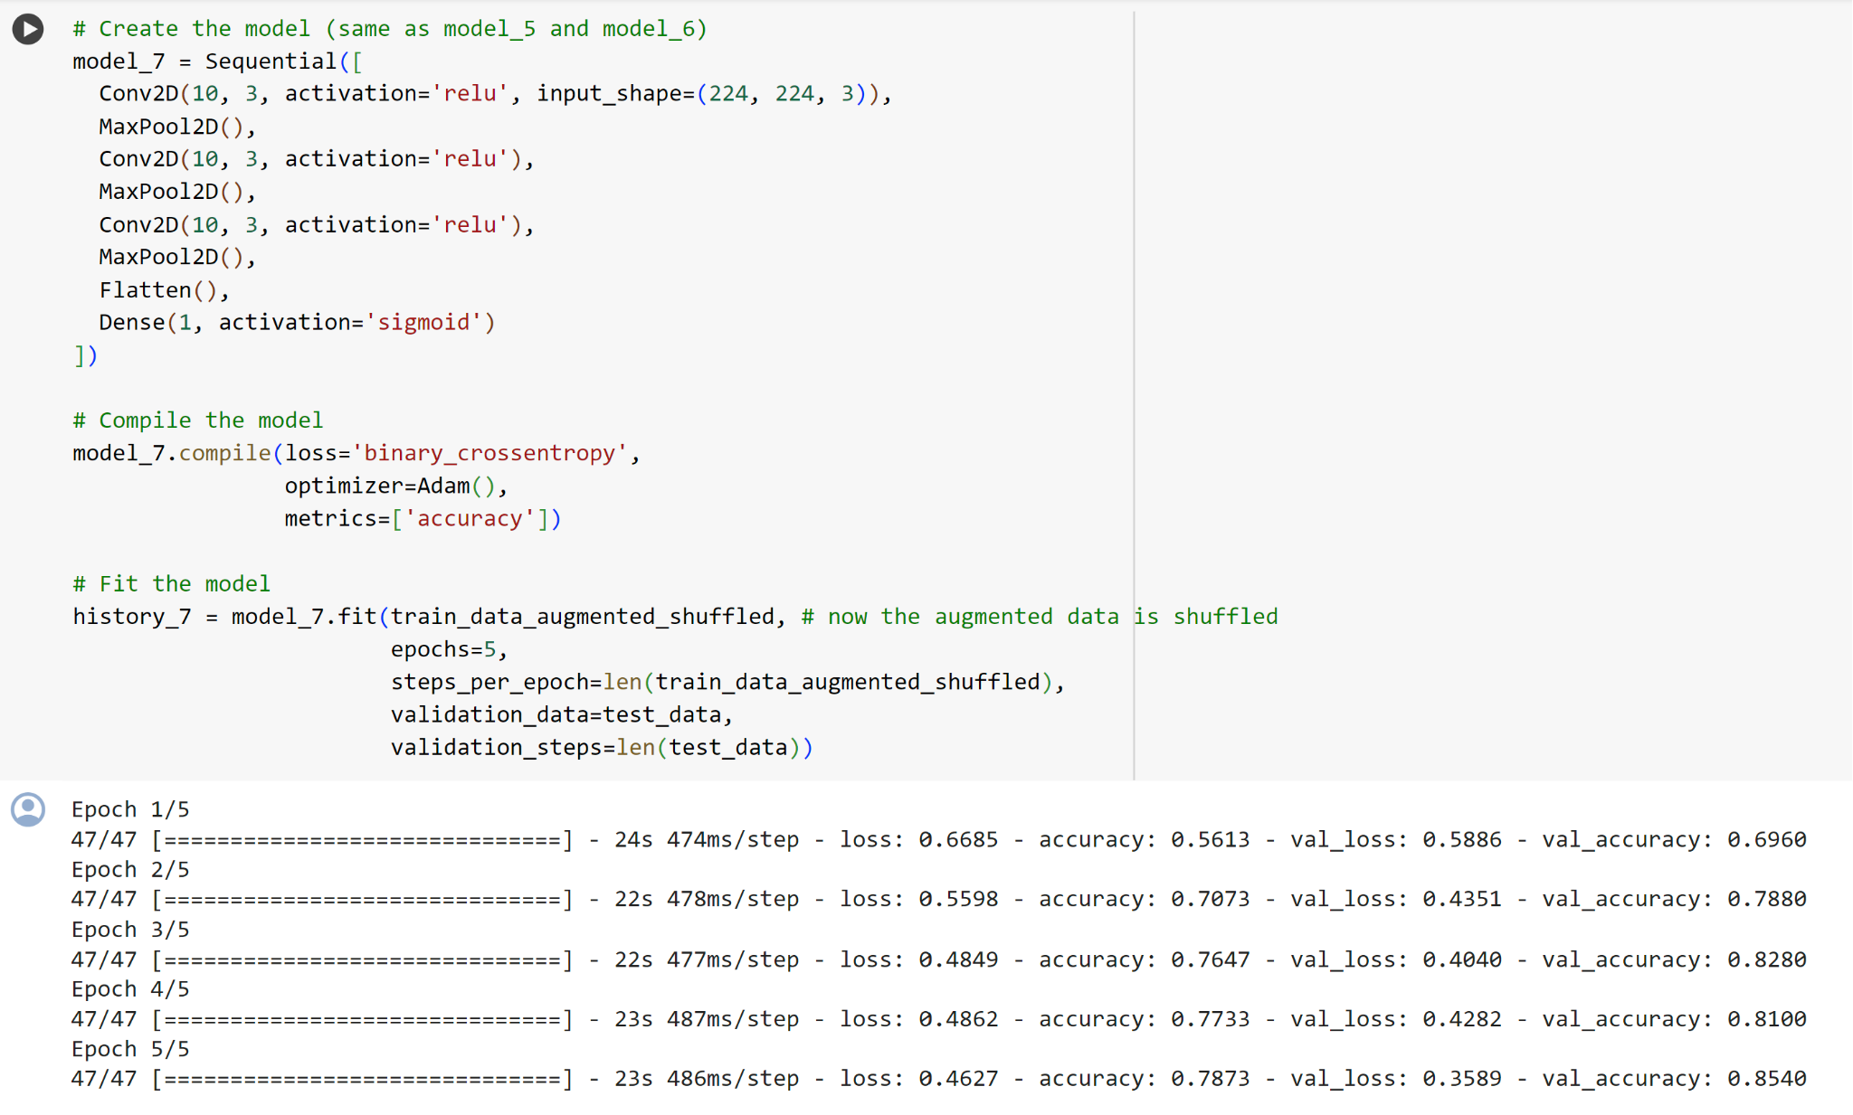
Notes:
Notice with model_7 how the performance on the training dataset improves almost immediately compared to model_6. This is because we shuffled the training data as we passed it to the model using the parameter shuffle=True in the flow_from_directory method.
This means the model was able to see examples of both pizza and steak images in each batch and in turn be evaluated on what it learned from both images rather than just one kind.
Also, our loss curves look a little bit smoother with shuffled data (comparing history_6 to history_7).

Slide 46
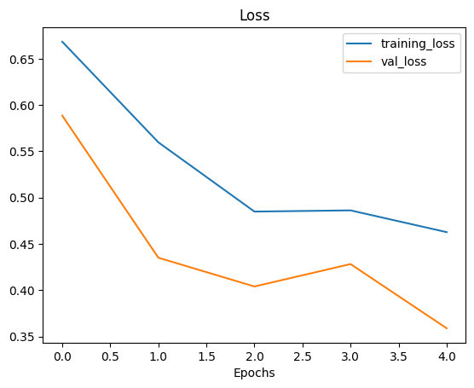
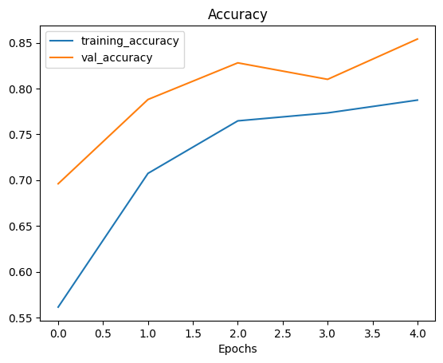

Slide 47
7. Repeat until satisfied
Since we've already beaten our baseline, there are a few things we could try to continue to improve our model:
Increase the number of model layers (e.g. add more convolutional layers).
Increase the number of filters in each convolutional layer (e.g. from 10 to 32, 64, or 128, these numbers aren't set in stone either, they are usually found through trial and error).
Train for longer (more epochs).
Finding an ideal learning rate.
Get more data (give the model more opportunities to learn).
Use transfer learning to leverage what another image model has learned and adjust it for our own use case.
Adjusting each of these settings (except for the last two) during model development is usually referred to as hyperparameter tuning.
Notes:
You can think of hyperparameter tuning as simialr to adjusting the settings on your oven to cook your favourite dish. Although your oven does most of the cooking for you, you can help it by tweaking the dials.

Slide 48
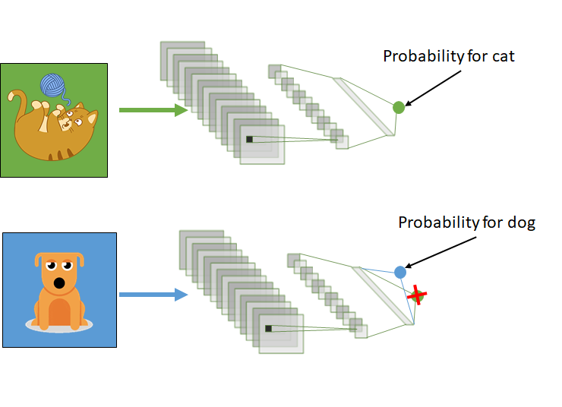
What is Transfer Learning
The reuse of a pre-trained model on a new problem is known as transfer learning in machine learning
A machine uses the knowledge learned from a prior assignment to increase prediction about a new task in transfer learning
The knowledge of an already trained machine learning model is transferred to a different but closely linked problem throughout transfer learning
Notes:
The reuse of a pre-trained model on a new problem is known as transfer learning in machine learning. A machine uses the knowledge learned from a prior assignment to increase prediction about a new task in transfer learning. You could, for example, use the information gained during training to distinguish beverages when training a classifier to predict whether an image contains cuisine.
The knowledge of an already trained machine learning model is transferred to a different but closely linked problem throughout transfer learning. For example, if you trained a simple classifier to predict whether an image contains a backpack, you could use the model’s training knowledge to identify other objects such as sunglasses.

Slide 49
With transfer learning, we basically try to use what we’ve learned in one task to better understand the concepts in another. weights are being automatically being shifted to a network performing “task A” from a network that performed new “task B.”
Because of the massive amount of CPU power required, transfer learning is typically applied in computer vision and natural language processing tasks like sentiment analysis.

Slide 50
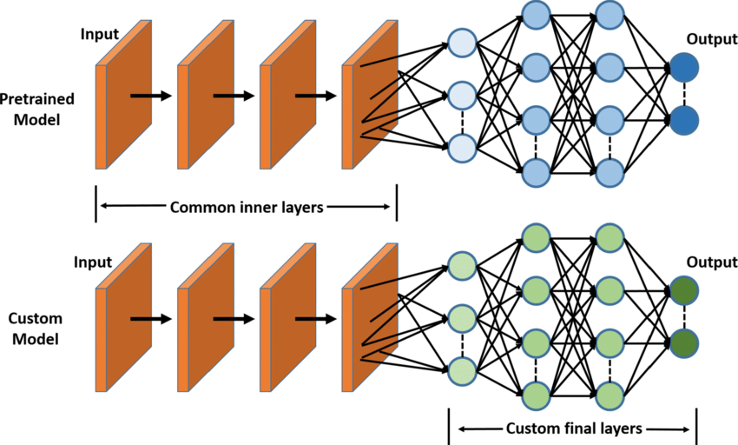
How transfer learning works?
Notes:
In computer vision, neural networks typically aim to detect edges in the first layer, forms in the middle layer, and task-specific features in the latter layers.
The early and central layers are employed in transfer learning, and the latter layers are only retrained. It makes use of the labelled data from the task it was trained on.
Let’s return to the example of a model that has been intended to identify a backpack in an image and will now be used to detect sunglasses. Because the model has trained to recognise objects in the earlier levels, we will simply retrain the subsequent layers to understand what distinguishes sunglasses from other objects.

Slide 51
Why should we use transfer learning?
Reduced training time
Improved neural network performance (in most circumstances)
The absence of a large amount of data.
Notes:
To train a neural model from scratch, a lot of data is typically needed, but access to that data isn’t always possible – this is when transfer learning comes in handy.
Because the model has already been pre-trained, a good machine learning model can be generated with fairly little training data using transfer learning. This is especially useful in natural language processing, where huge labelled datasets require a lot of expert knowledge. Additionally, training time is decreased because building a deep neural network from the start of a complex task can take days or even weeks.

Slide 52
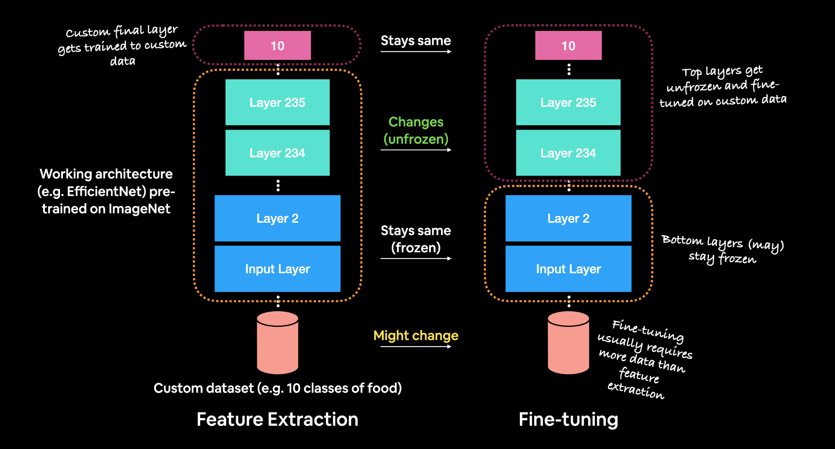
Transfer learning: Fine Tuning
Notes:
In fine-tuning transfer learning the pre-trained model weights from another model are unfrozen and tweaked during to better suit your own data.
In fine-tuning transfer learning, you might train 1-3+ layers of a pre-trained model (where the '+' indicates that many or all of the layers could be trained).

Slide 53
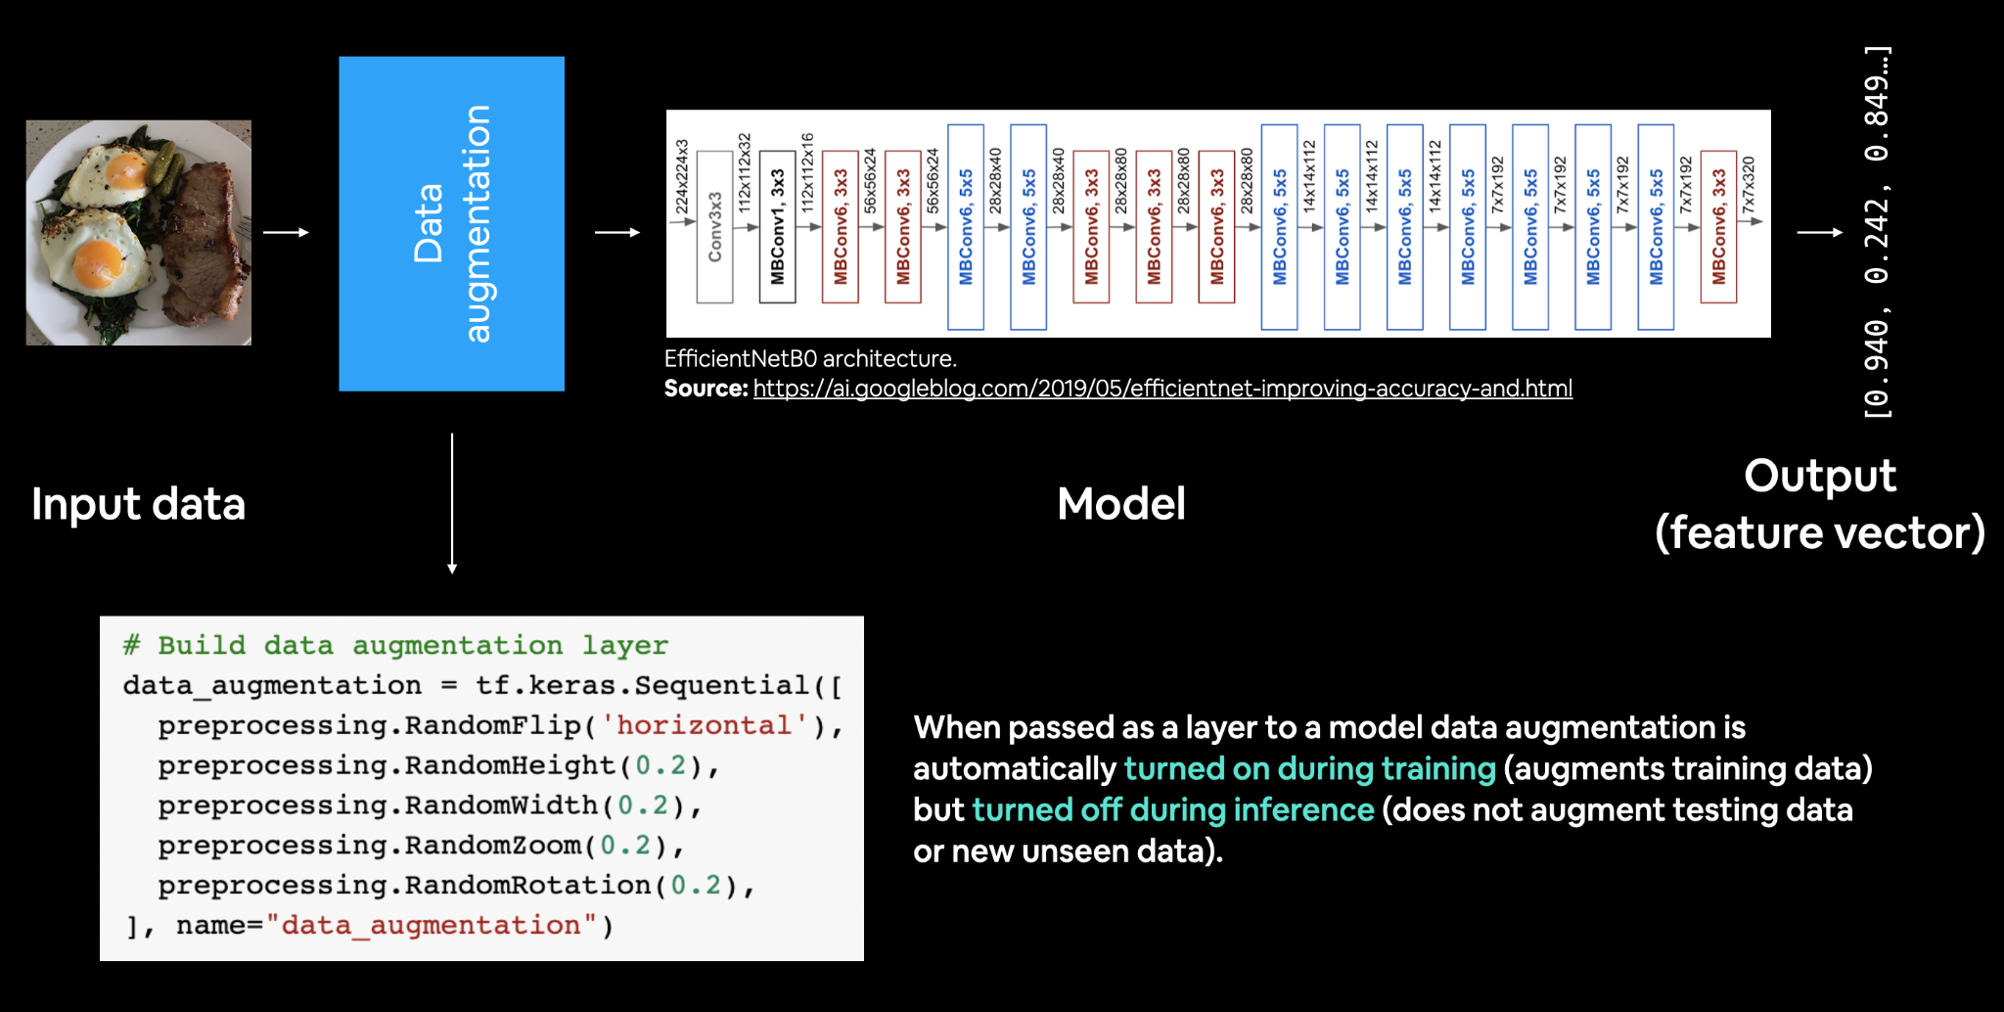
Using the tf.keras.layers module and creating a dedicated data augmentation layer.
Notes:
Previously we've used the different parameters of the ImageDataGenerator class to augment our training images, this time we're going to build data augmentation right into the model.
How?
Using the tf.keras.layers module and creating a dedicated data augmentation layer.

Slide 54
Adding a data augmentation layer to the model has the following benefits:
Preprocessing of the images (augmenting them) happens on the GPU rather than on the CPU (much faster).
Images are best preprocessed on the GPU where as text and structured data are more suited to be preprocessed on the CPU.
Image data augmentation only happens during training so we can still export our whole model and use it elsewhere. And if someone else wanted to train the same model as us, including the same kind of data augmentation, they could.

Slide 55
The data augmentation transformations we're going to use are:
tf.keras.layers.RandomFlip - flips image on horizontal or vertical axis.
tf.keras.layersRandomRotation - randomly rotates image by a specified amount.
tf.keras.layers.RandomZoom - randomly zooms into an image by specified amount.
tf.keras.layers.RandomHeight - randomly shifts image height by a specified amount.
tf.keras.layers.RandomWidth - randomly shifts image width by a specified amount.
tf.keras.layers.Rescaling - normalizes the image pixel values to be between 0 and 1, this is worth mentioning because it is required for some image models but since we're using tf.keras.applications.efficientnet_v2.EfficientNetV2B0, it's not required (the model pretrained model implements rescaling itself)

Slide 56


Slide 57


Slide 58


Slide 59

Creating a ModelCheckpoint callback
Notes:
Our model is compiled and ready to be fit, so why haven't we fit it yet?
Well, for this experiment we're going to introduce a new callback, the ModelCheckpoint callback.
The ModelCheckpoint callback gives you the ability to save your model, as a whole in the SavedModel format or the weights (patterns) only to a specified directory as it trains.
This is helpful if you think your model is going to be training for a long time and you want to make backups of it as it trains. It also means if you think your model could benefit from being trained for longer, you can reload it from a specific checkpoint and continue training from there.
For example, say you fit a feature extraction transfer learning model for 5 epochs and you check the training curves and see it was still improving and you want to see if fine-tuning for another 5 epochs could help, you can load the checkpoint, unfreeze some (or all) of the base model layers and then continue training.
In fact, that's exactly what we're going to do.
But first, let's create a ModelCheckpoint callback. To do so, we have to specifcy a directory we'd like to save to.

Slide 60
What's the difference between saving the entire model (SavedModel format) and saving the weights only?
The SavedModel format saves a model's architecture, weights and training configuration all in one folder. It makes it very easy to reload your model exactly how it is elsewhere. However, if you do not want to share all of these details with others, you may want to save and share the weights only (these will just be large tensors of non-human interpretable numbers). If disk space is an issue, saving the weights only is faster and takes up less space than saving the whole model.

Slide 61

Notes:
Time to fit the model.
Because we're going to be fine-tuning it later, we'll create a variable initial_epochs and set it to 5 to use later.
We'll also add in our checkpoint_callback in our list of callbacks.

Slide 62


Notes:
Looking at these, our model's performance with 10% of the data and data augmentation isn't as good as the model with 10% of the data without data augmentation (see model_0 results above), however the curves are trending in the right direction, meaning if we decided to train for longer, its metrics would likely improve.

Slide 63


Slide 64




Transfer Learning QR Codes
MLDA Handbook
https://docs.google.com/spreadsheets/d/1xPrLgY6E_iNN2R0jU0MEf8N75Xcn5FIM--ruNihjrqU/edit#gid=1925502567
LEARNOVA Playlist
https://www.youtube.com/playlist?list=PLXpIV63PRtvXM5I-6Fv9Z1s3tXV91n636
Quiz
https://forms.gle/H6naog7cx4fjMfEU7
Feedback https://forms.gle/pChmChS5VLR4FHQE9

